Slide 1

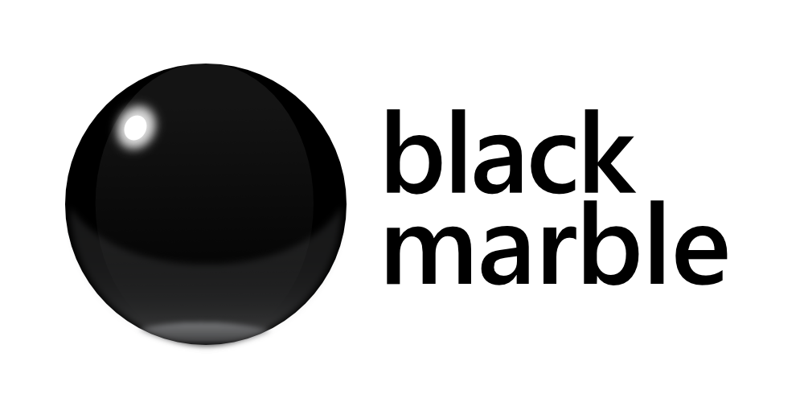

Intro to Microsoft Bot Framework V4
James Mann
Microsoft MVP & Development Consultant
Black Marble @jamesemann
Notes:
Today we are going to look at creating Bots with Microsoft Bot Framework.
Because I am a .NET developer, the examples I will show you today are in C#. But everything you see here can be done with Node JS as well.

Slide 2


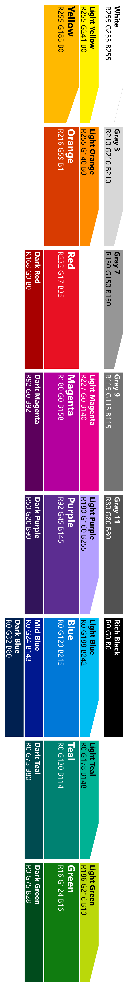
Agenda
Introduction
What is a chatbot
Why chatbots?
What is Bot Framework
Adding Bots
Dialogs
Adding Middleware
QnA Maker
Bot smarts
luis.ai
Cards
Proactive Bot
Notes:
So how do we deliver this ‘layering’?
We use dialog transitions
There’s more , but these are the important ones

Slide 3
Code + recorded demos + slides
<GITHUB URL>
Notes:
So how do we deliver this ‘layering’?
We use dialog transitions
There’s more , but these are the important ones

Slide 4
What is a chatbot?
@jamesemann
Notes:
Helpful to understand what a chatbot actually is because the term bot is quite overloaded
So by way of example you will see that

Slide 5
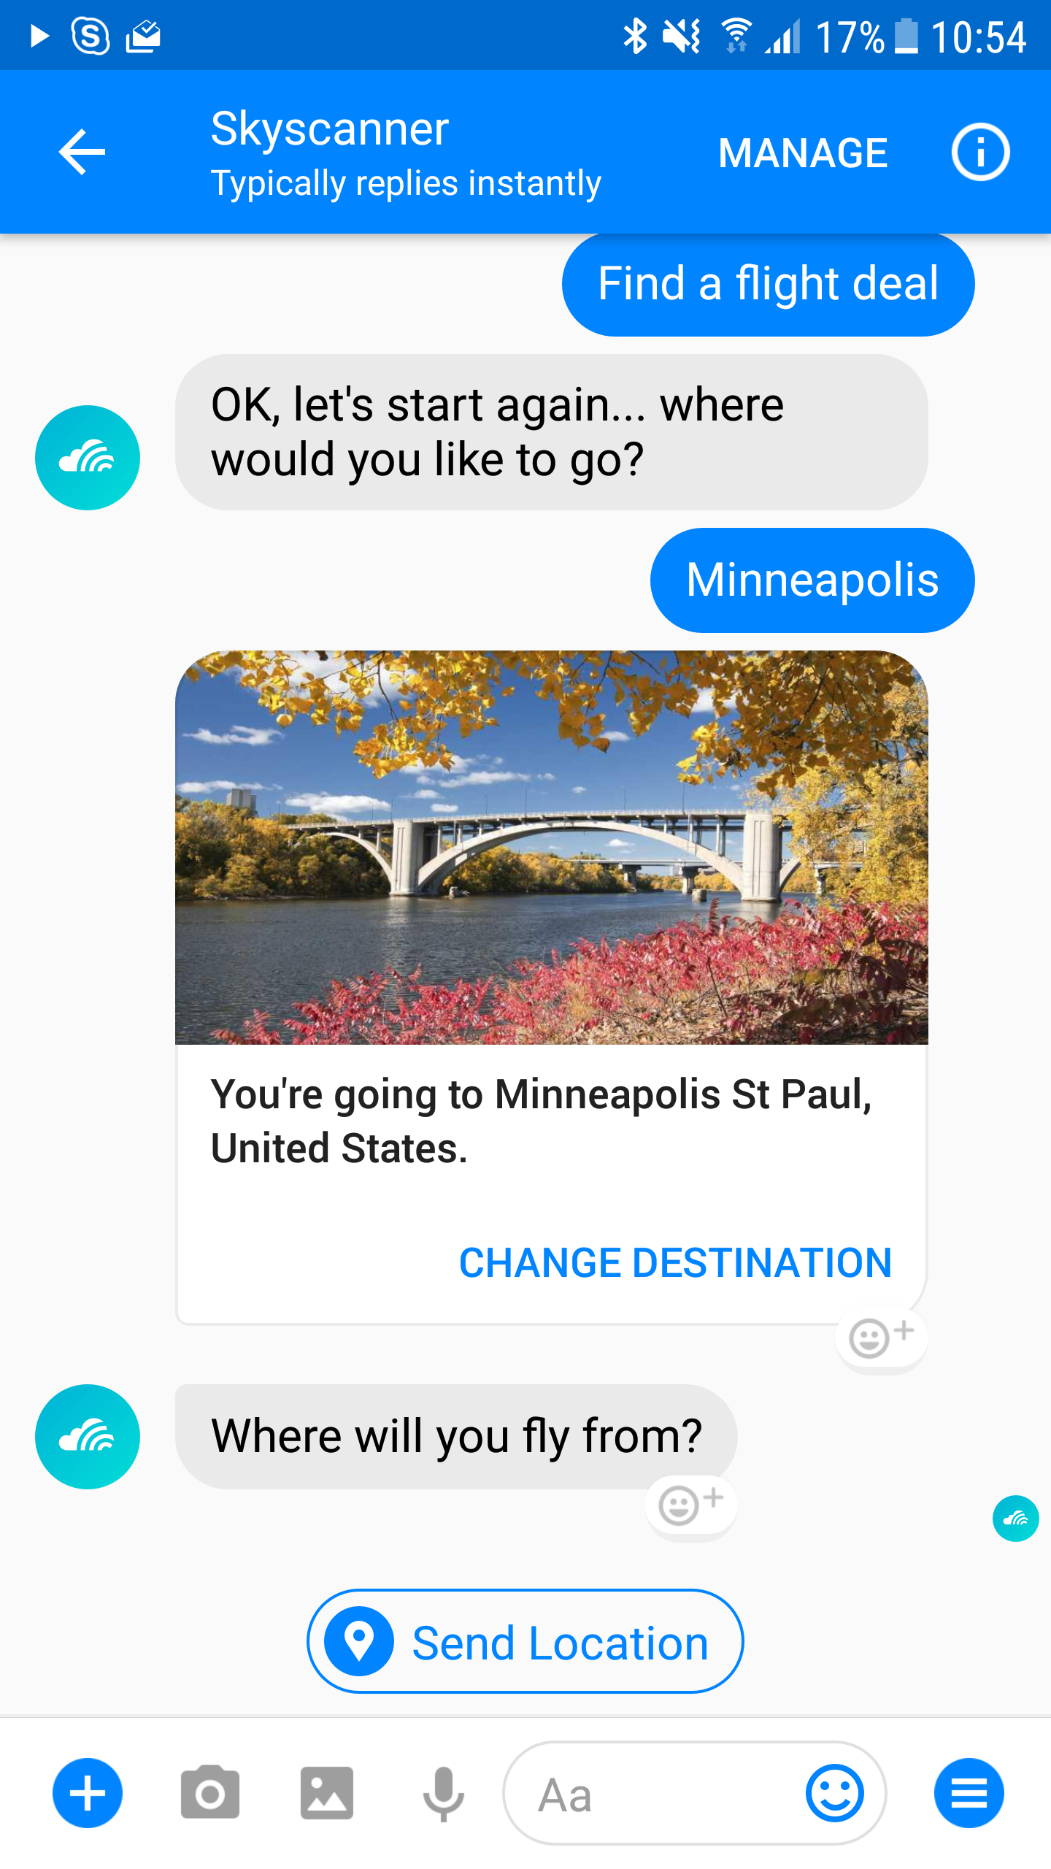
Notes:
I am calling a bot, a software application that is delivered over messaging applications
This may use a conversational interface, or command and control
This example is skyscanner, it lets you find out about flights without installing any software
It’s a nice natural—in this case conversational– interface
That has a really low barrier to entry.

Slide 6

Notes:
But also consider less conventional applications “accessible through email” as bots as well
x.ai is a popular scheduling assistant, that can help avoid scheduling ping pong between meeting participants. Microsoft have a similar email scheduling bot calendar.help

Slide 7
Why chatbots?
@jamesemann
Notes:
That was a quick definition of a bot, so lets talk about why they have become popular

Slide 8
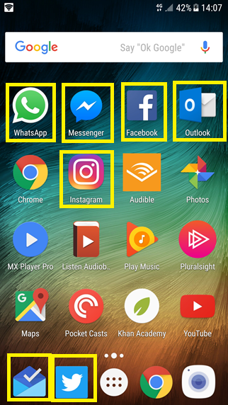
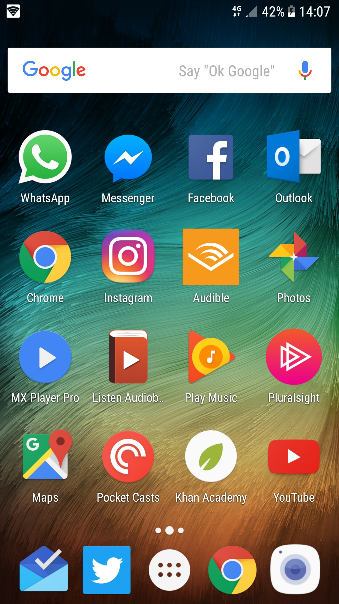
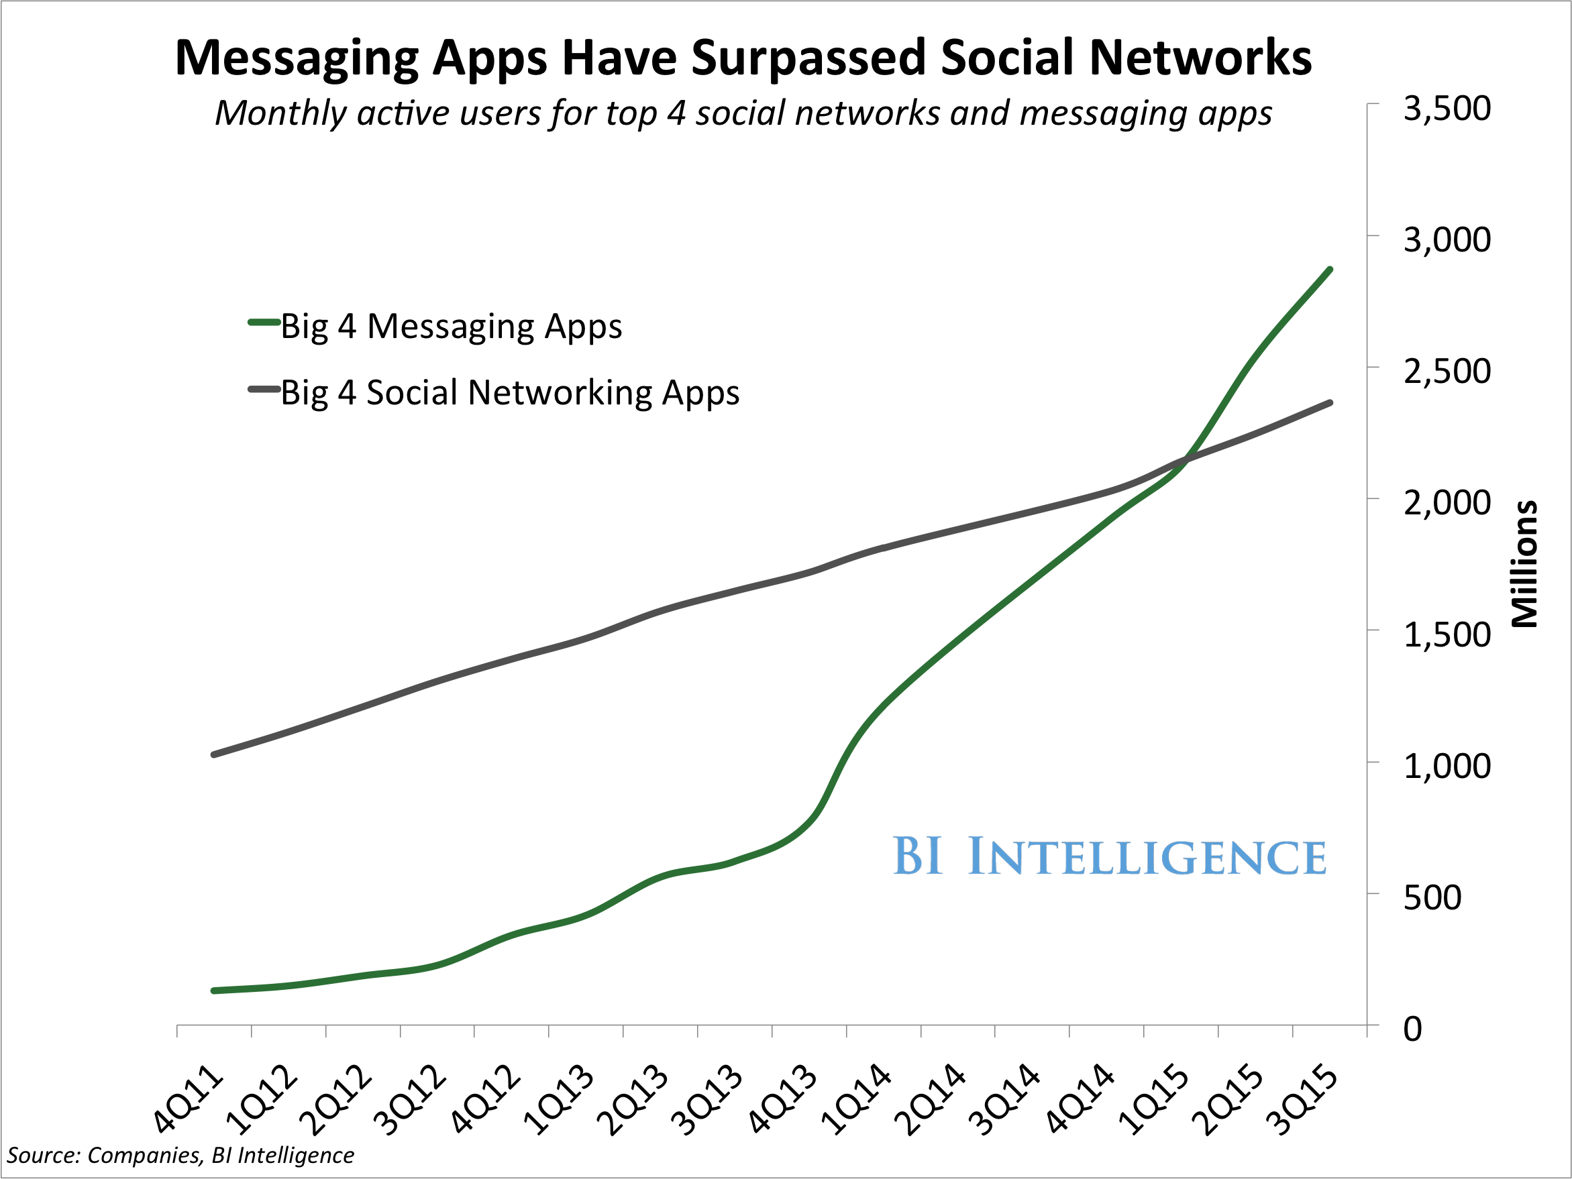
Distribution
Over 4 billion global users using messaging platforms
6 out of the top 10 apps used globally are messaging apps
Notes:
So the big selling point is distribution.
Everyone has a device on them. People are addicted to their phones, and particularly messenger apps.
Chatbots take advantage of this by using messenger apps and virtual assistants to reach users where they are already active.
Take a look at your phone home screen. Count how many messaging/assistant apps you have on there. Count things like email too because you have seen that chatbots can be delivered across all these channels.
It’s a really compelling distribution story and I think it is the number one reason for chatbot hype.

Slide 9














Messaging ecosystem
Notes:
So digging into it from a bot framework perspective. There are 12 messaging channels supporting messaging apps and virtual assistants. 3 new channels were announced at //BUILD –
Bing search
Skype for business
cortana

Slide 10
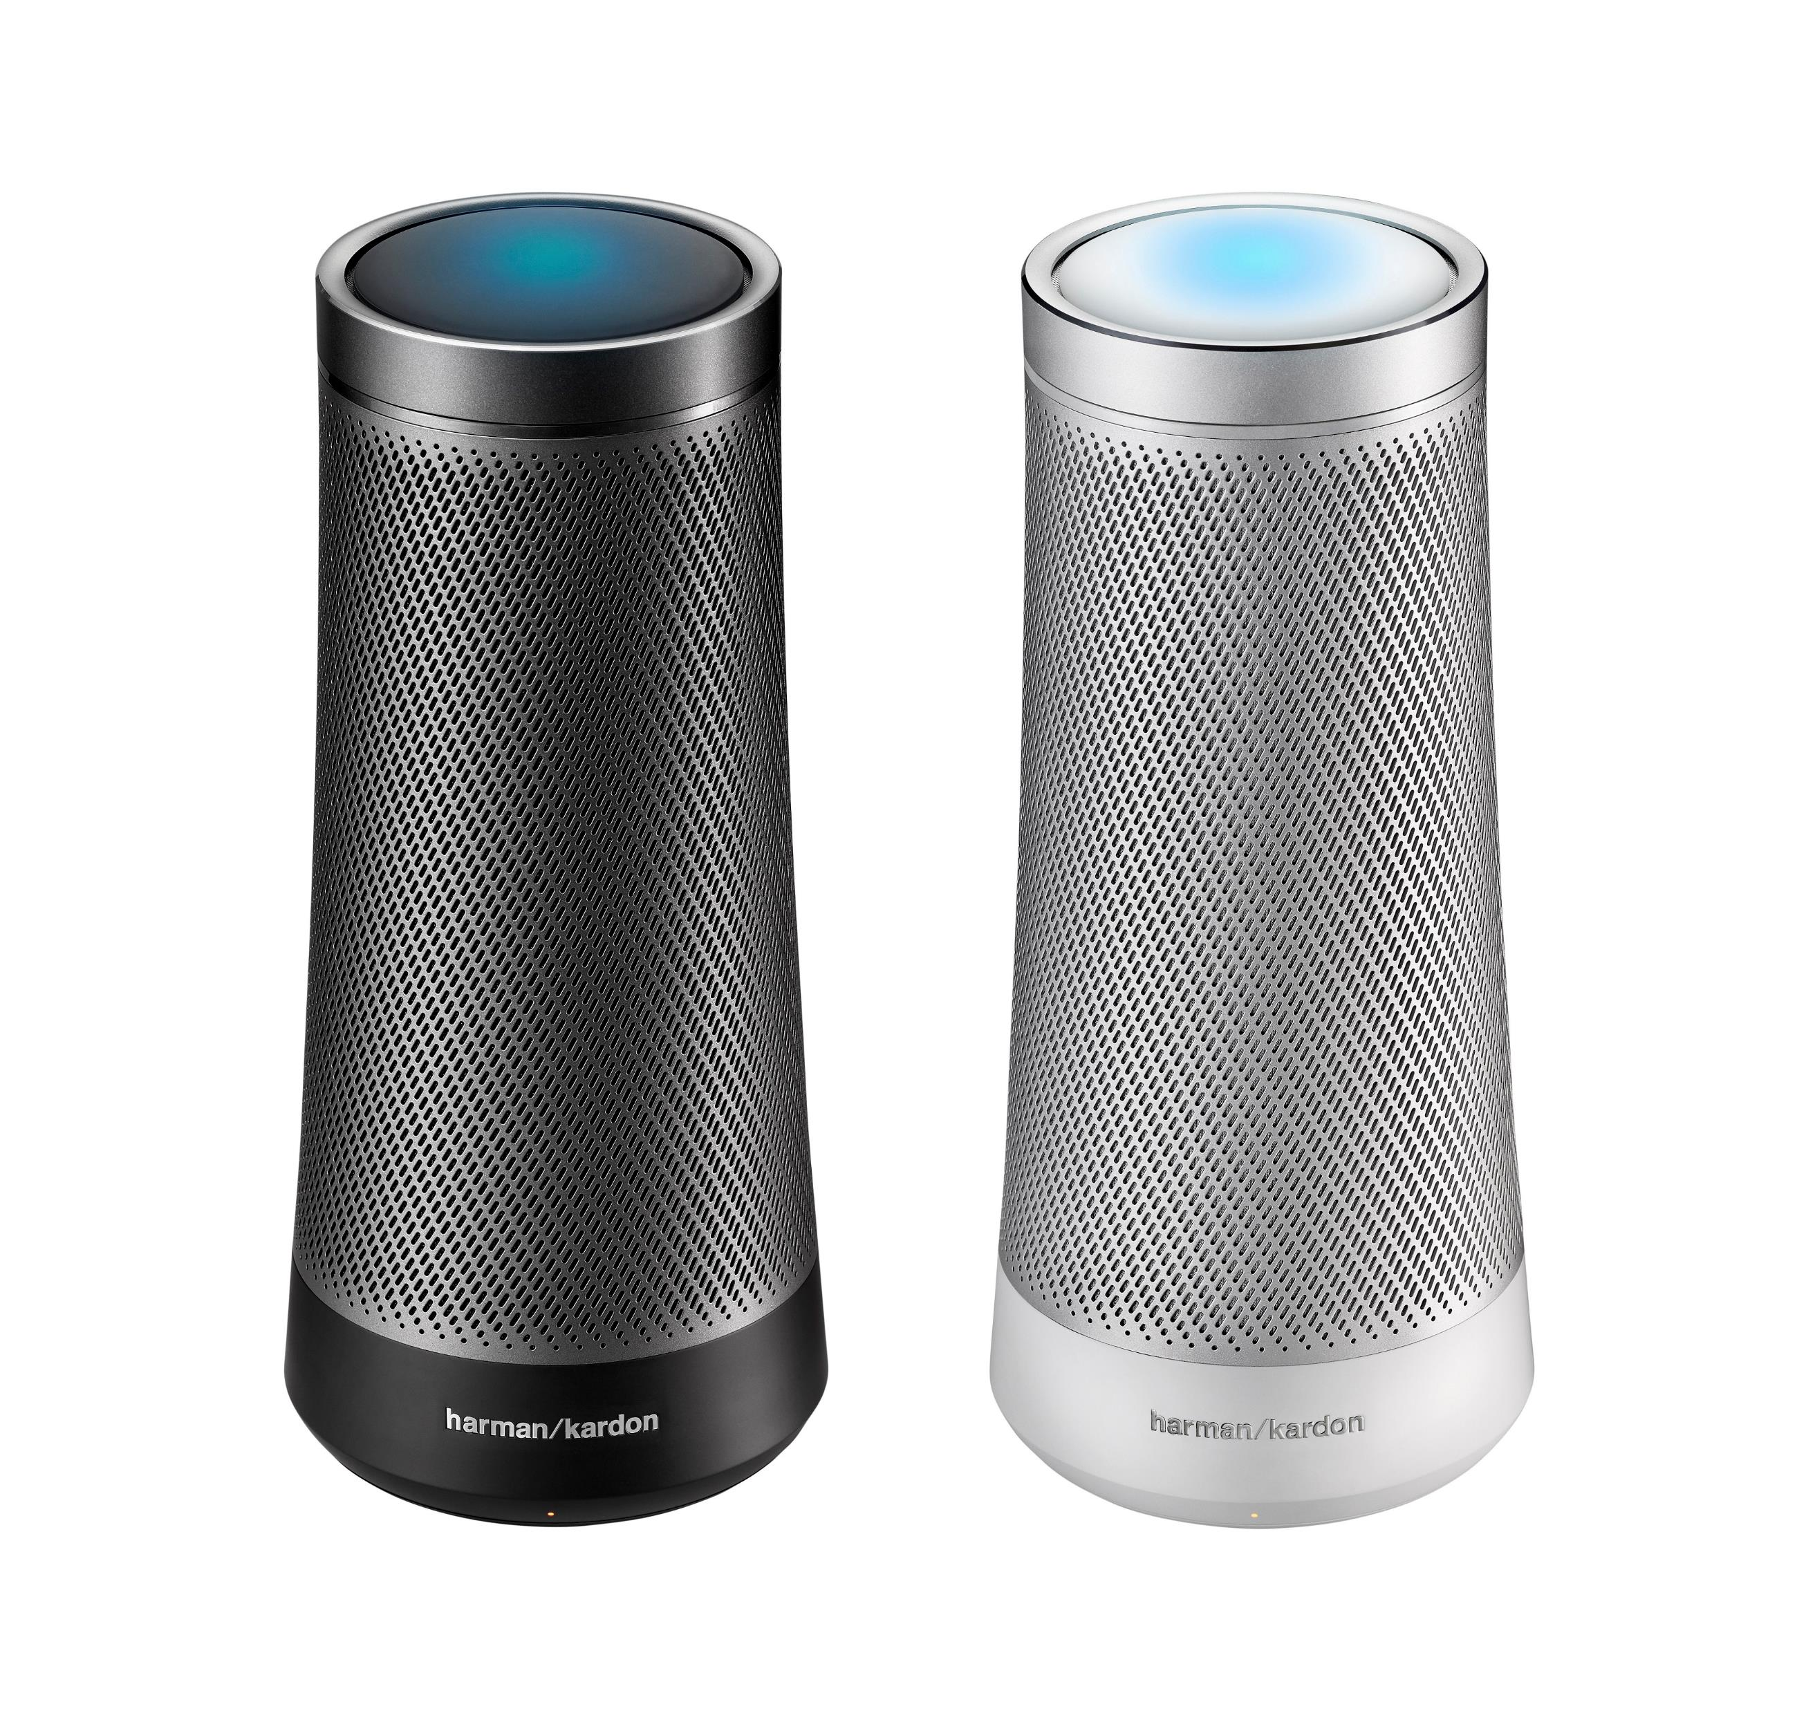
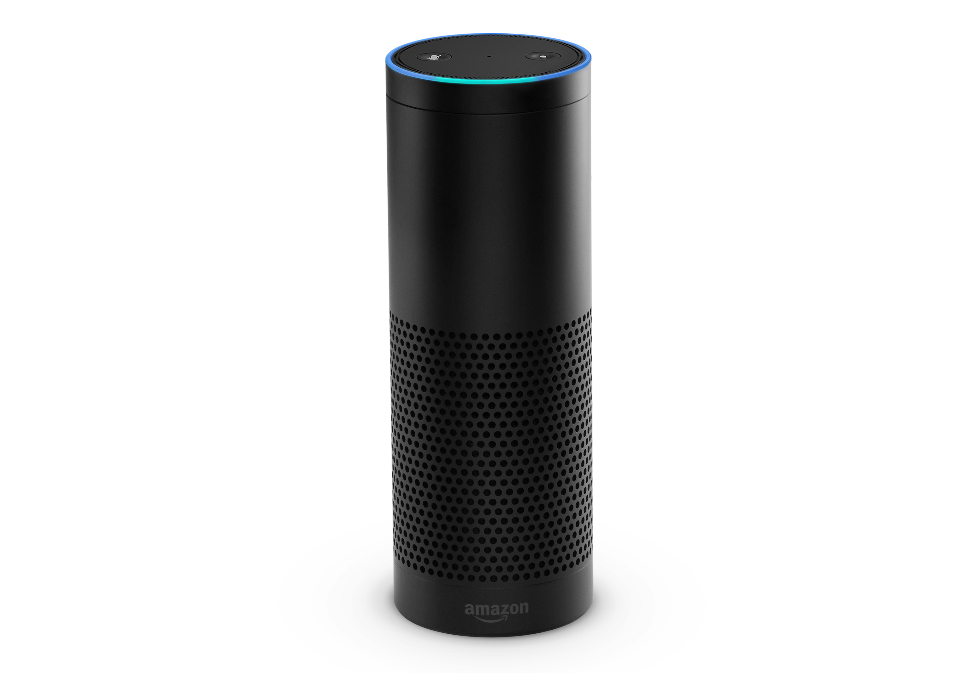
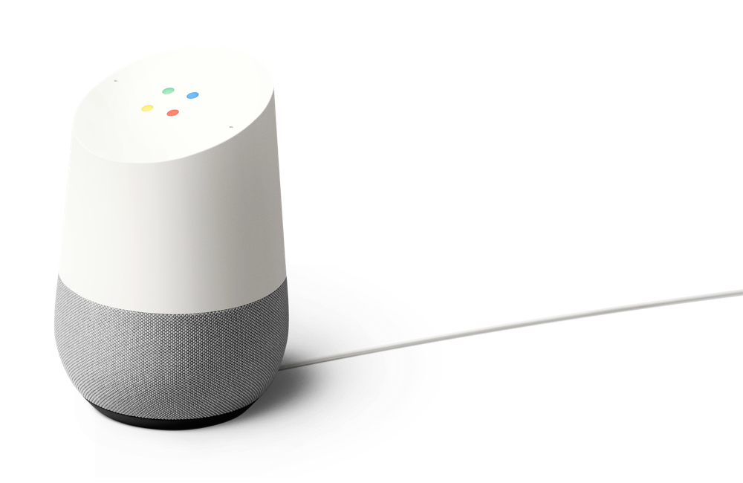
Virtual assistant device ecosystem
Notes:
And these dedicated virtual assistant devices are becoming mainstream.
Everyone has seen the examples GOOD and BAD of amazon alexa.
Google home has recently become available in the UK
And dedicated cortana devices are on their way.

Slide 11
Use cases are everywhere
Customer Service
Shopping Experience
Help Desk
Employee Support
FAQ
Account queries
Resolve order issues
Parcel Tracking
Transport queries (bus, train)
Recommend product
Flight, hotel booking
Improving search
Find the right product
Problem troubleshooting
New user on-boarding
Response suggestion
Product information
Data insights
Find the right expert
HR – booking holiday, fault reporting
Meeting room booking
Notes:
So there are tons of use cases for chatbots. Some are just delivering existing functionality through a new experience, but others, like x.ai are bot first applications, made possible with the distribution and channel capabilities.
Not every use case is appropriate though. Bots tend to work very well when the application is precise.
Here I’ve highlighted an example of a use case that doesn’t work very well. If you think of how a lot of people shop, they don’t typically have a specific product already in mind. They want to maybe browse a catalogue, and discover and get a wide range of inspiration before narrowing down their product. Chatbots make this difficult because the canvas capabilities require information to be more precise.

Slide 12
What is Bot Framework?
@jamesemann
Notes:
Introductions and Agenda (2 Mins)
Introduce Simon, Gary, James
Set expectations: intro to bot framework.
Very quick demo of JUST EAT to show what a bot is
What we are going to cover

Slide 13
Targeting multiple channels is complex
How do you make a chatbot work with both Slack and Teams?
What about bringing an existing chatbot to new channels?
It would mean rewriting large amounts of code
Notes:
So how do we deliver this ‘layering’?
We use dialog transitions
There’s more , but these are the important ones

Slide 14
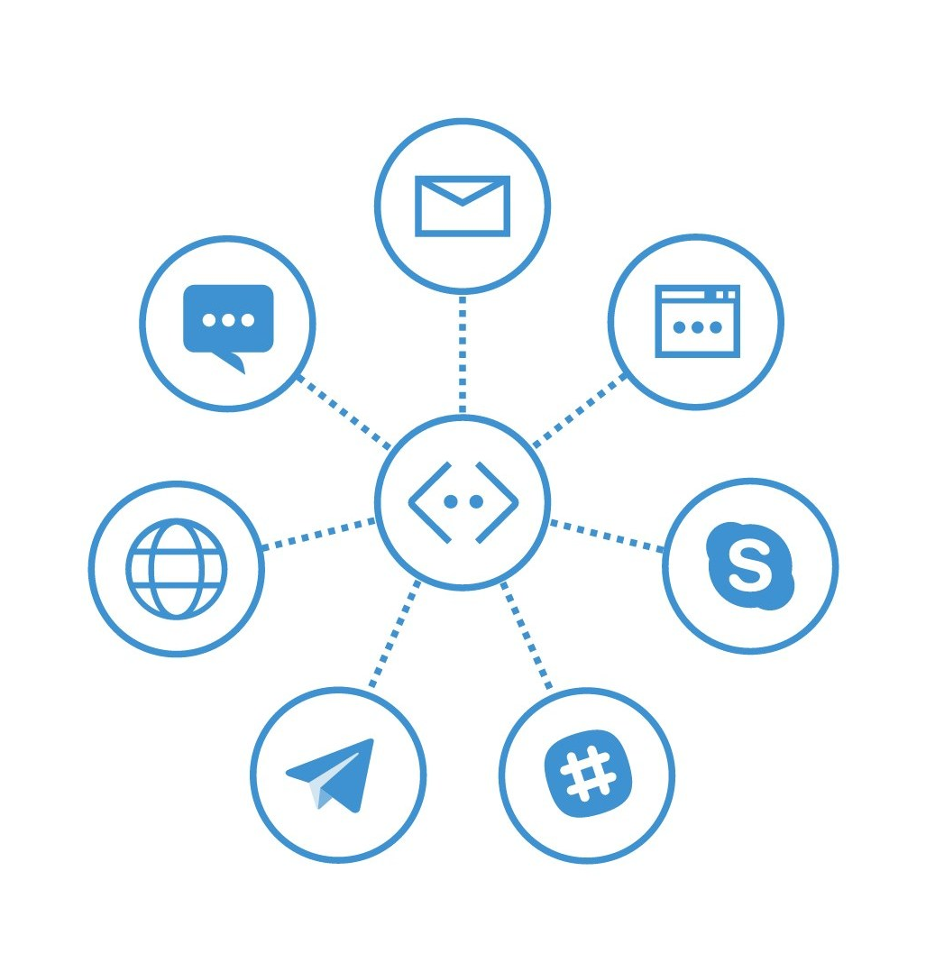
Bot Framework
Build one Bot
Host one Bot
Maintain one Bot
Target multiple channels
Notes:
So how do we deliver this ‘layering’?
We use dialog transitions
There’s more , but these are the important ones

Slide 15
BotBuilder v4
A response to the developer community
Less opinionated
4 flavours (.NET core, Node, Python & Java)
Bring your own implementation (ioc, logging, persistence etc)
Bring your own tooling
Languages are more aligned
Follow same principles, language semantics are different
Notes:
So how do we deliver this ‘layering’?
We use dialog transitions
There’s more , but these are the important ones

Slide 16
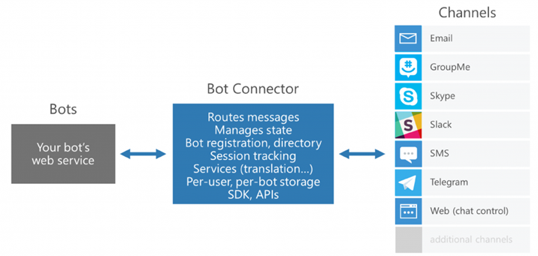
Bot Framework Architecture
Notes:
So how do we deliver this ‘layering’?
We use dialog transitions
There’s more , but these are the important ones

Slide 17
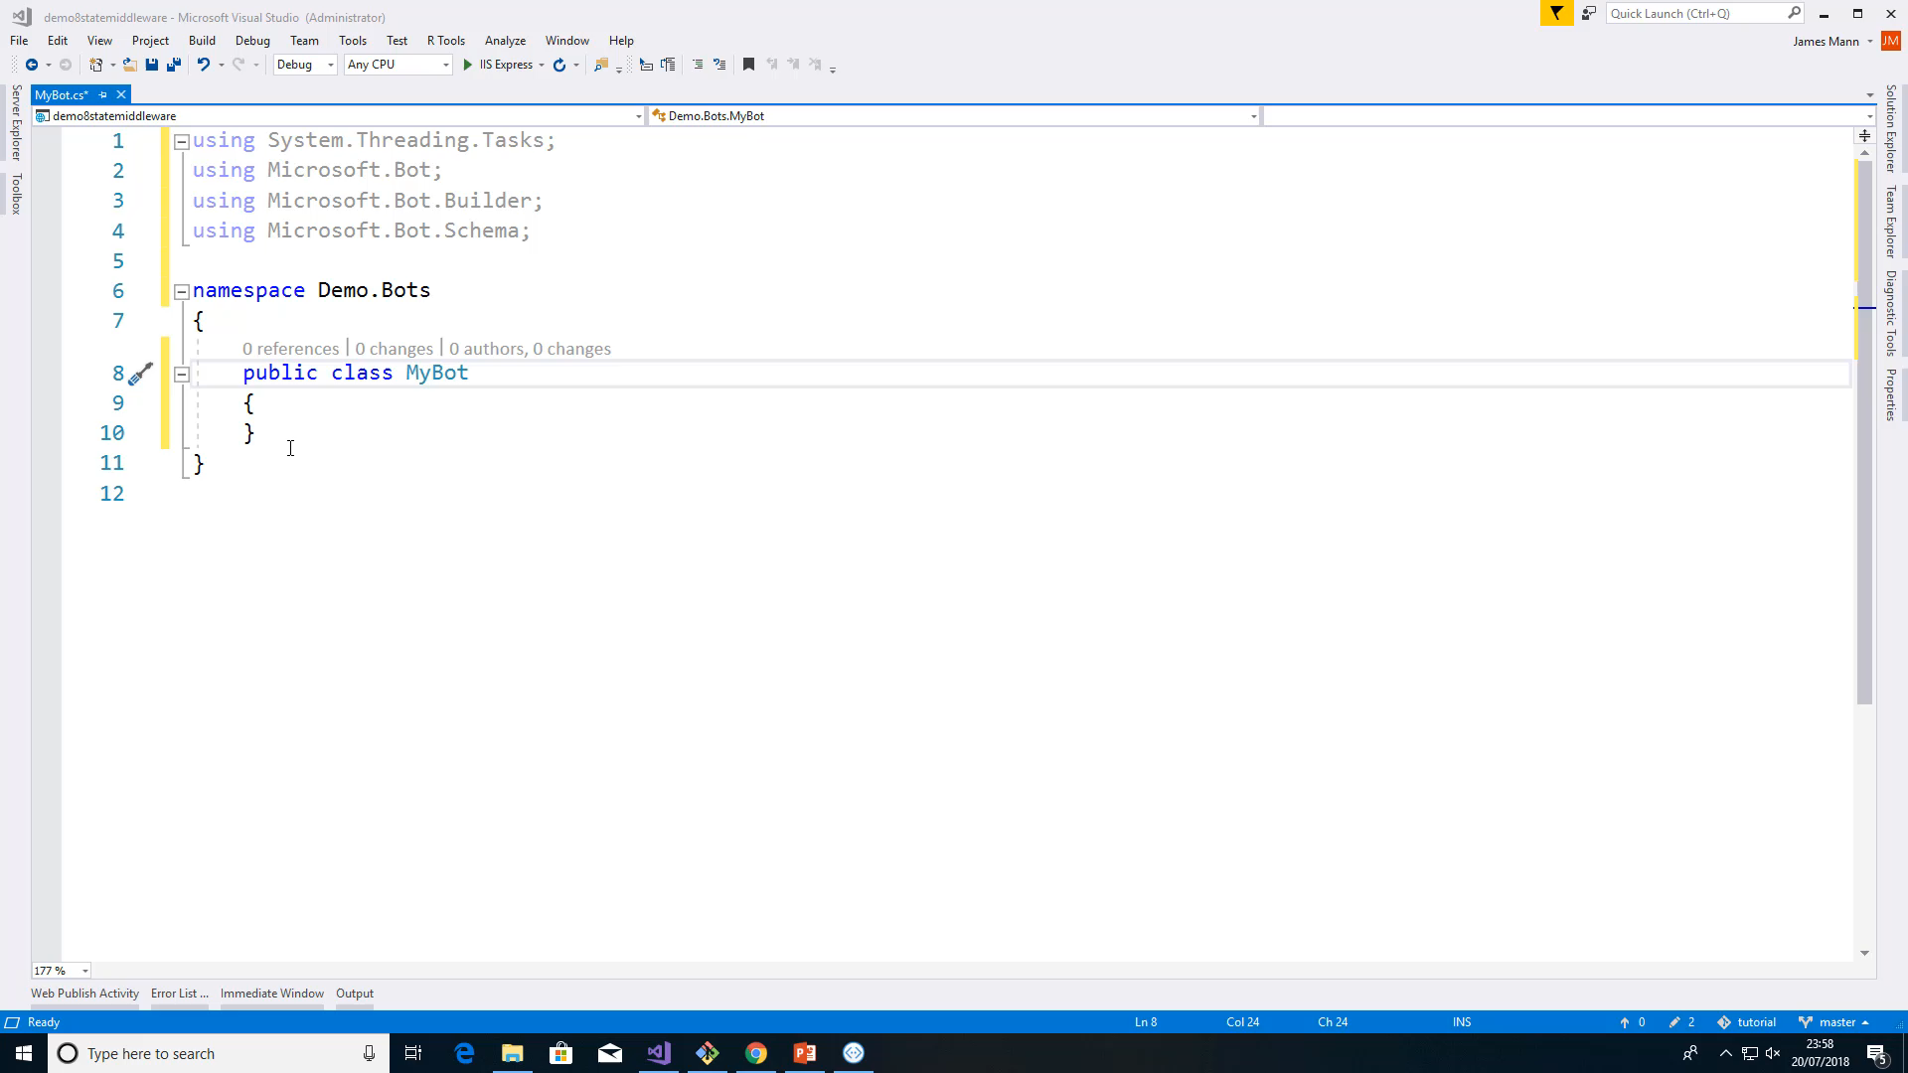
Step 1: Build
Build your chatbot using
.NET
JavaScript
Python
Java
Notes:
First you register the Bot.
You give your bot a name, an icon, provide an API endpoint that it will talk to.

Slide 18
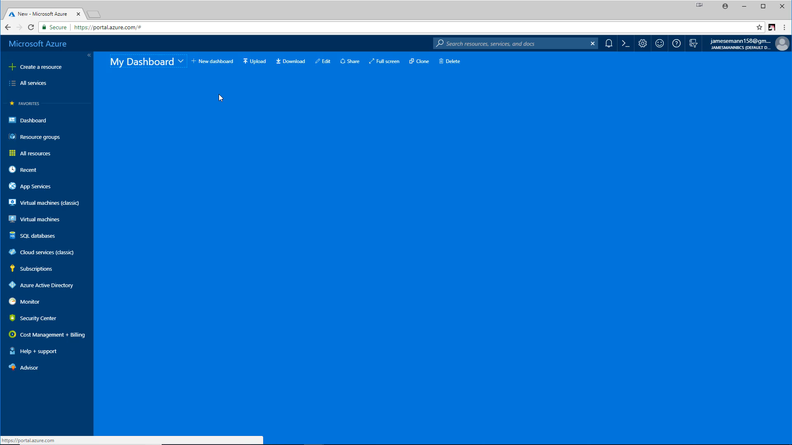
Step 2: Register
Register your chatbot using
Azure CLI msbot extension
Azure Portal
Notes:
First you register the Bot.
You give your bot a name, an icon, provide an API endpoint that it will talk to.

Slide 19
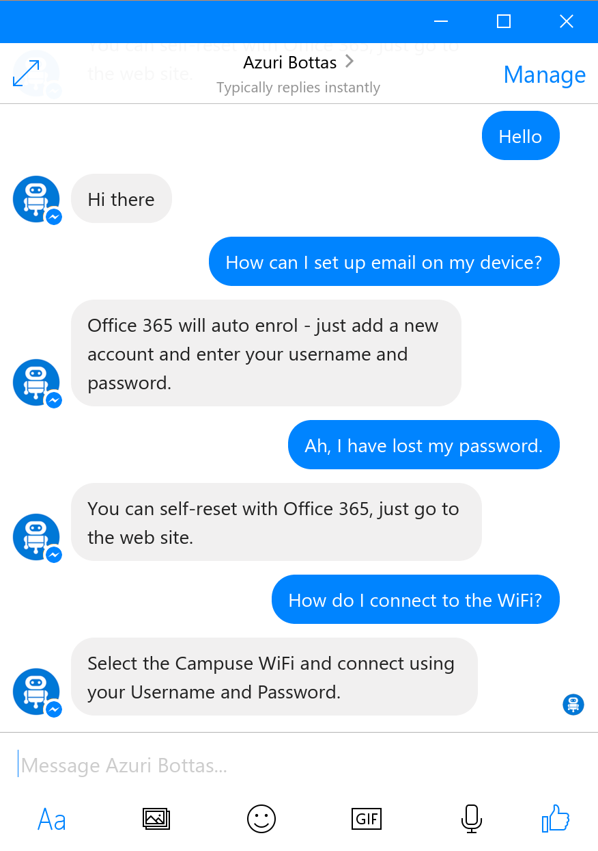
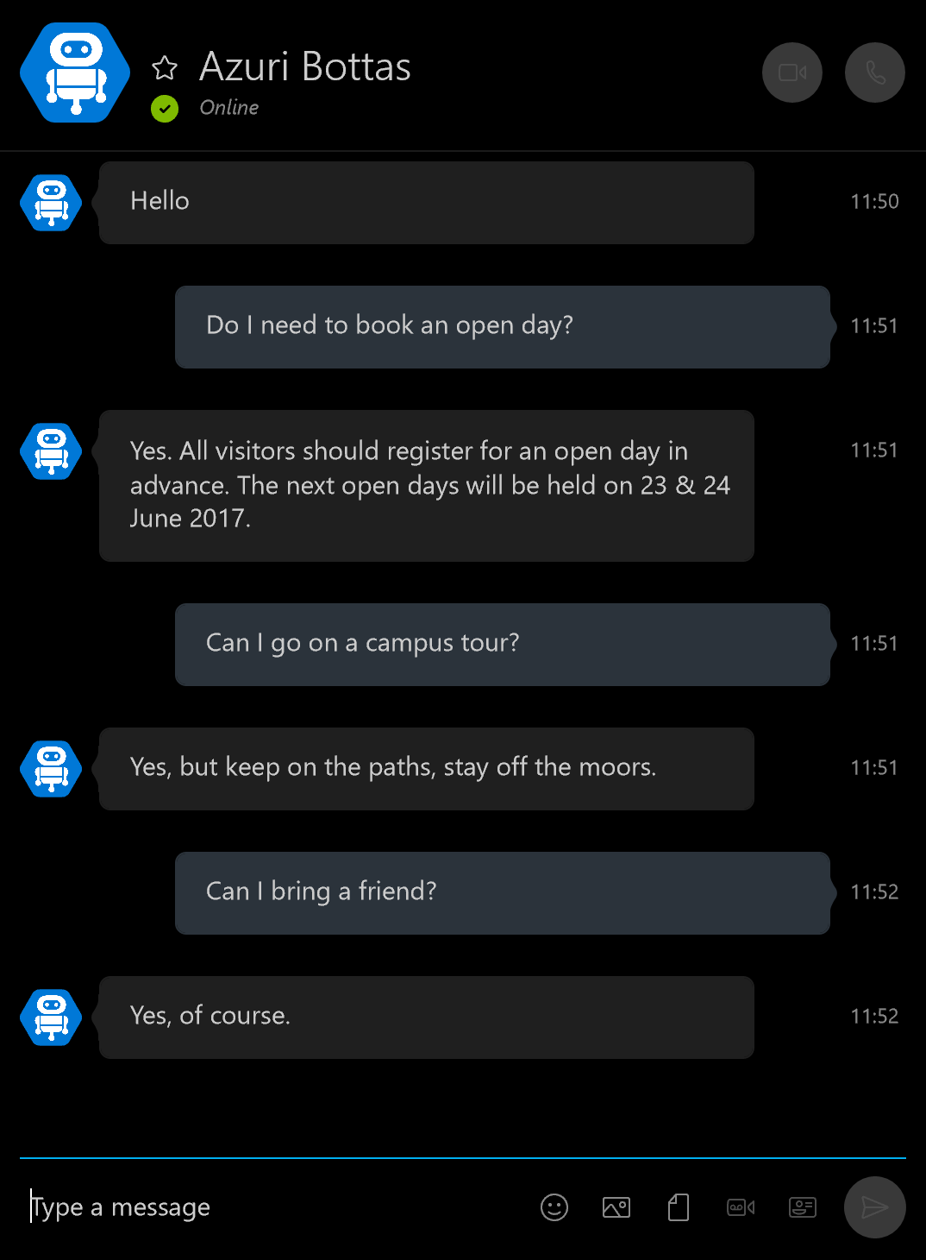


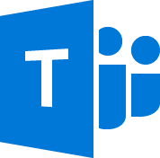






Distribute
Facebook Messenger
Skype
& more!
Notes:
Then you distribute.
This is all done by turning on the channel in the portal. once you have defined your Bot application and does not require code changes!
Here I am exposing my bot over facebook, then skype,
I can choose at any time, to distribute to any of the other channels currently supported by Bot framework.
And – a key benefit – if channels are added in future – my bot is already future proof!

Slide 20
Demo
Your first Bot
@jamesemann
Notes:
Introductions and Agenda (2 Mins)
Introduce Simon, Gary, James
Set expectations: intro to bot framework.
Very quick demo of JUST EAT to show what a bot is
What we are going to cover

Slide 21
Modelling your conversation
Roll your own
state management etc
Bespoke
Multi layered conversations
Multiple turn (Dialogs)
Flexibility
Questions and answers/FAQ
Single turn
Effort to implement
Notes:
So when you are first starting your conversation, you have a decision to make about which tools you use.
This depends on the type of conversation.
I’ve tried to show this in the diagram
along the bottom is the amount of effort required to implement.
Along the side is the amount of flexibility
So basically,
if you have a simple bot scenario you are going to be looking at the bottom left
If you have a complex scenario you are going to be looking at the top right
We are going to be focussing on Dialogs, which gives you benefits of state management, persistence etc while giving you a good level of flexibility

Slide 22
Adding Bots
@jamesemann
Notes:
Introductions and Agenda (2 Mins)
Introduce Simon, Gary, James
Set expectations: intro to bot framework.
Very quick demo of JUST EAT to show what a bot is
What we are going to cover

Slide 23
Bots
To implement a bot, create an instance of IBot
Your bot must implement OnTurn()
OnTurn() is called every time a message is received
Notes:
So how do we deliver this ‘layering’?
We use dialog transitions
There’s more , but these are the important ones

Slide 24
Adding your Bot – Step 1
Create a class which implements IBot
public class MyBot : IBot
{
public async Task OnTurn(ITurnContext turnContext)
{
if (turnContext.Activity.Type == ActivityTypes.Message)
{
await turnContext.SendActivity($"You said {turnContext.Activity.Text}");
}
}
}
Indent 1.3cm
Notes:
So how do we deliver this ‘layering’?
We use dialog transitions
There’s more , but these are the important ones

Slide 25
Adding your Bot – Step 2
Register the class in Startup.cs
services.AddBot<SimpleBot>(options => {} );
Indent 1.3cm
Notes:
So how do we deliver this ‘layering’?
We use dialog transitions
There’s more , but these are the important ones

Slide 26
Adding Middleware
@jamesemann
Notes:
Introductions and Agenda (2 Mins)
Introduce Simon, Gary, James
Set expectations: intro to bot framework.
Very quick demo of JUST EAT to show what a bot is
What we are going to cover

Slide 27
Middleware
Middleware is cross-cutting functionality which is useful and reusable by different bots. For example:
Conversation state
Error handling
Natural language recognition or sentiment analysis
…
Notes:
So how do we deliver this ‘layering’?
We use dialog transitions
There’s more , but these are the important ones

Slide 28
Middleware pipeline
The Middleware pipeline contains:
0 or more IMiddleware classes
1 IBot class
next() invokes the next component in the pipeline.
If a piece of Middleware does not call next(), processing ends
Notes:
So how do we deliver this ‘layering’?
We use dialog transitions
There’s more , but these are the important ones

Slide 29
Middleware pipeline
Middleware 1
Middleware 2
Bot
Start turn
// do something before
next()
// do something before
next()
doSomething()
// do something after
// do something after
End turn
Notes:
So when you are first starting your conversation, you have a decision to make about which tools you use.
This depends on the type of conversation.
I’ve tried to show this in the diagram
along the bottom is the amount of effort required to implement.
Along the side is the amount of flexibility
So basically,
if you have a simple bot scenario you are going to be looking at the bottom left
If you have a complex scenario you are going to be looking at the top right
We are going to be focussing on Dialogs, which gives you benefits of state management, persistence etc while giving you a good level of flexibility

Slide 30
Adding your Middleware – Step 1
Create a class which implements IMiddleware
public class PassthroughMiddleware : IMiddleware
{
public async Task OnTurn(ITurnContext context, MiddlewareSet.NextDelegate next)
{
await context.SendActivity("I run before every received activity");
await next();
await context.SendActivity("I run after every received activity");
}
}
Indent 1.3cm
Notes:
So how do we deliver this ‘layering’?
We use dialog transitions
There’s more , but these are the important ones

Slide 31
Adding your Middleware – Step 2
Register the class in Startup.cs
services.AddBot<SimpleBot>(options =>
{
options.Middleware.Add(new PassthroughMiddleware());
});
Indent 1.3cm
Notes:
So how do we deliver this ‘layering’?
We use dialog transitions
There’s more , but these are the important ones

Slide 32
Demo
Adding passthrough Middleware
@jamesemann
Notes:
Introductions and Agenda (2 Mins)
Introduce Simon, Gary, James
Set expectations: intro to bot framework.
Very quick demo of JUST EAT to show what a bot is
What we are going to cover

Slide 33
Dialogs
@jamesemann
Notes:
Introductions and Agenda (2 Mins)
Introduce Simon, Gary, James
Set expectations: intro to bot framework.
Very quick demo of JUST EAT to show what a bot is
What we are going to cover

Slide 34
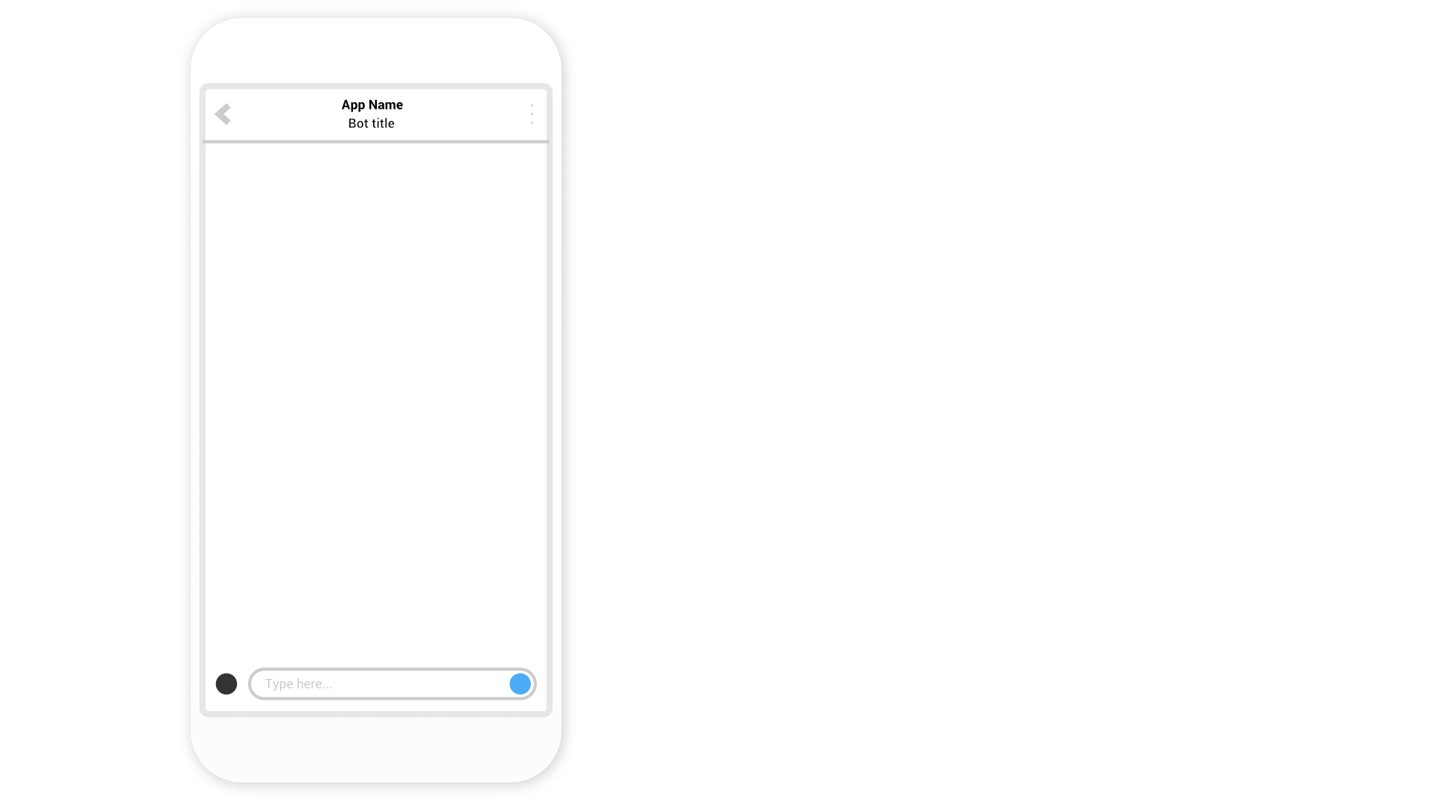
Notes:
Talk through an example of a BANKING BOT
Can do a couple of simple tasks
Check balance (savings or current)
And make a payment

Slide 36
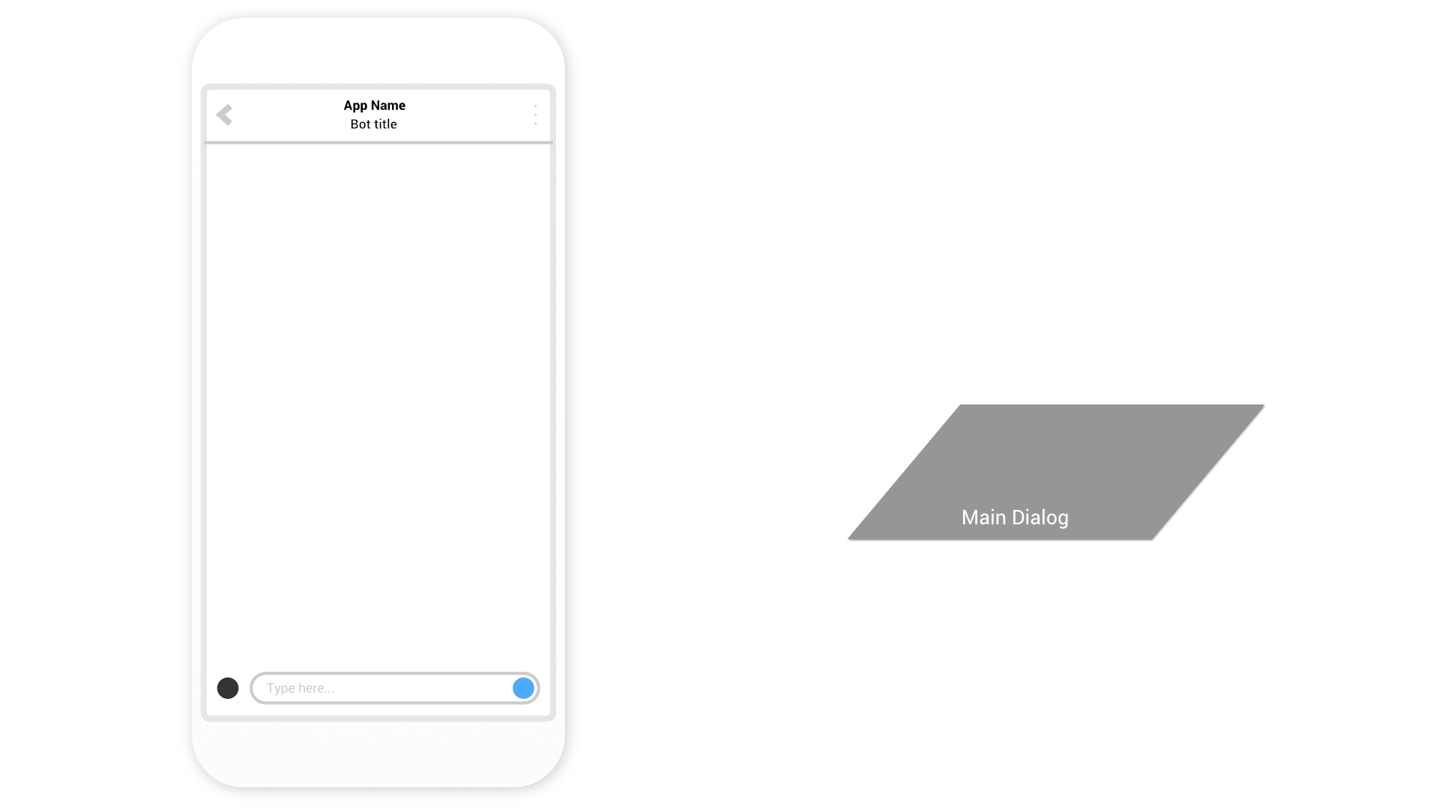

Slide 37


Slide 38
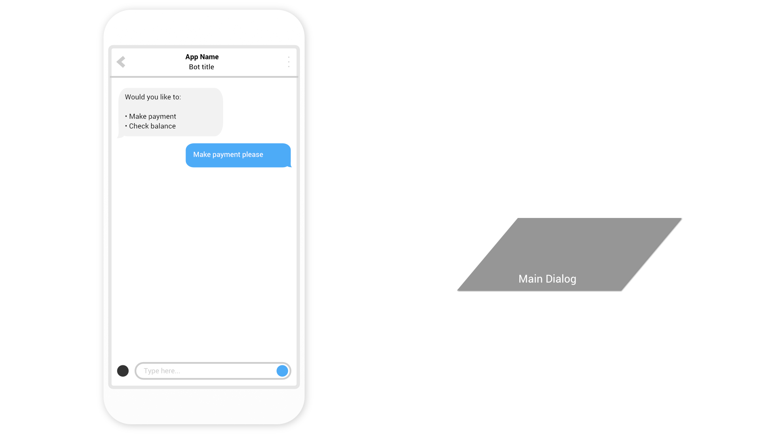

Slide 39
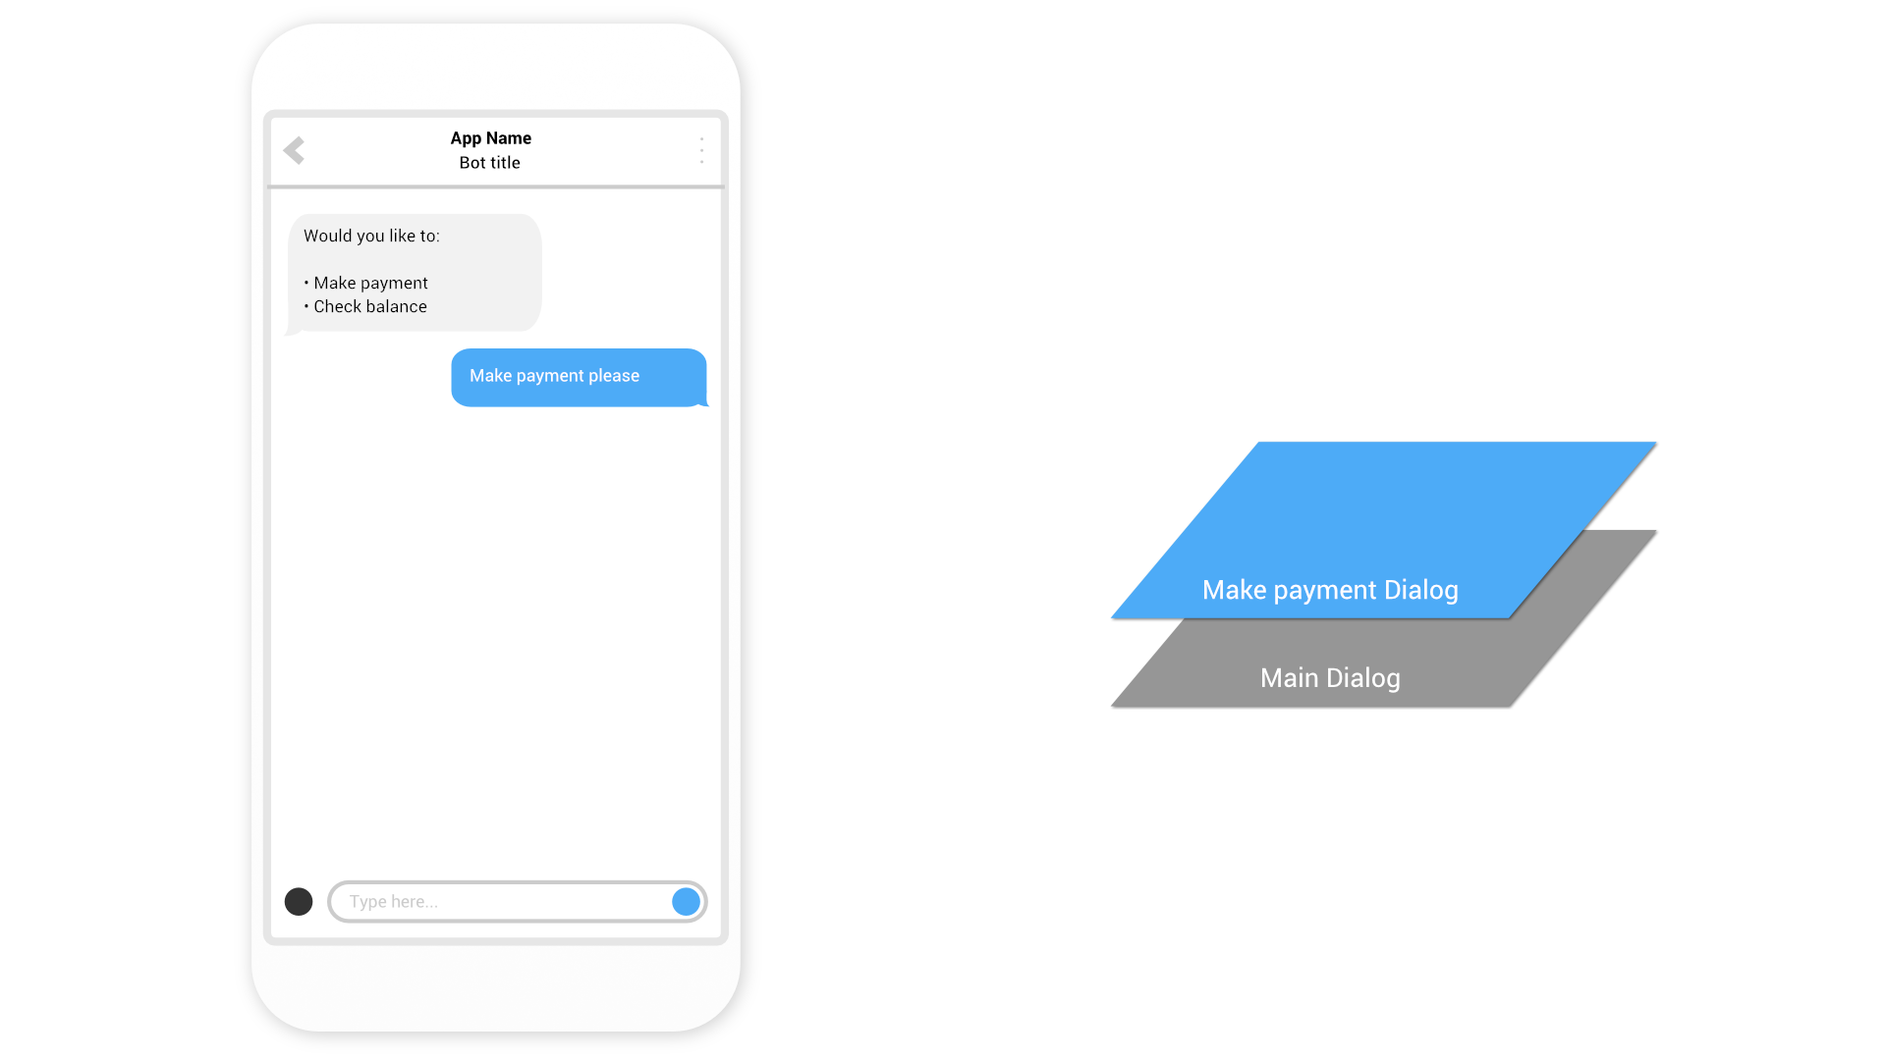

Slide 40


Slide 41
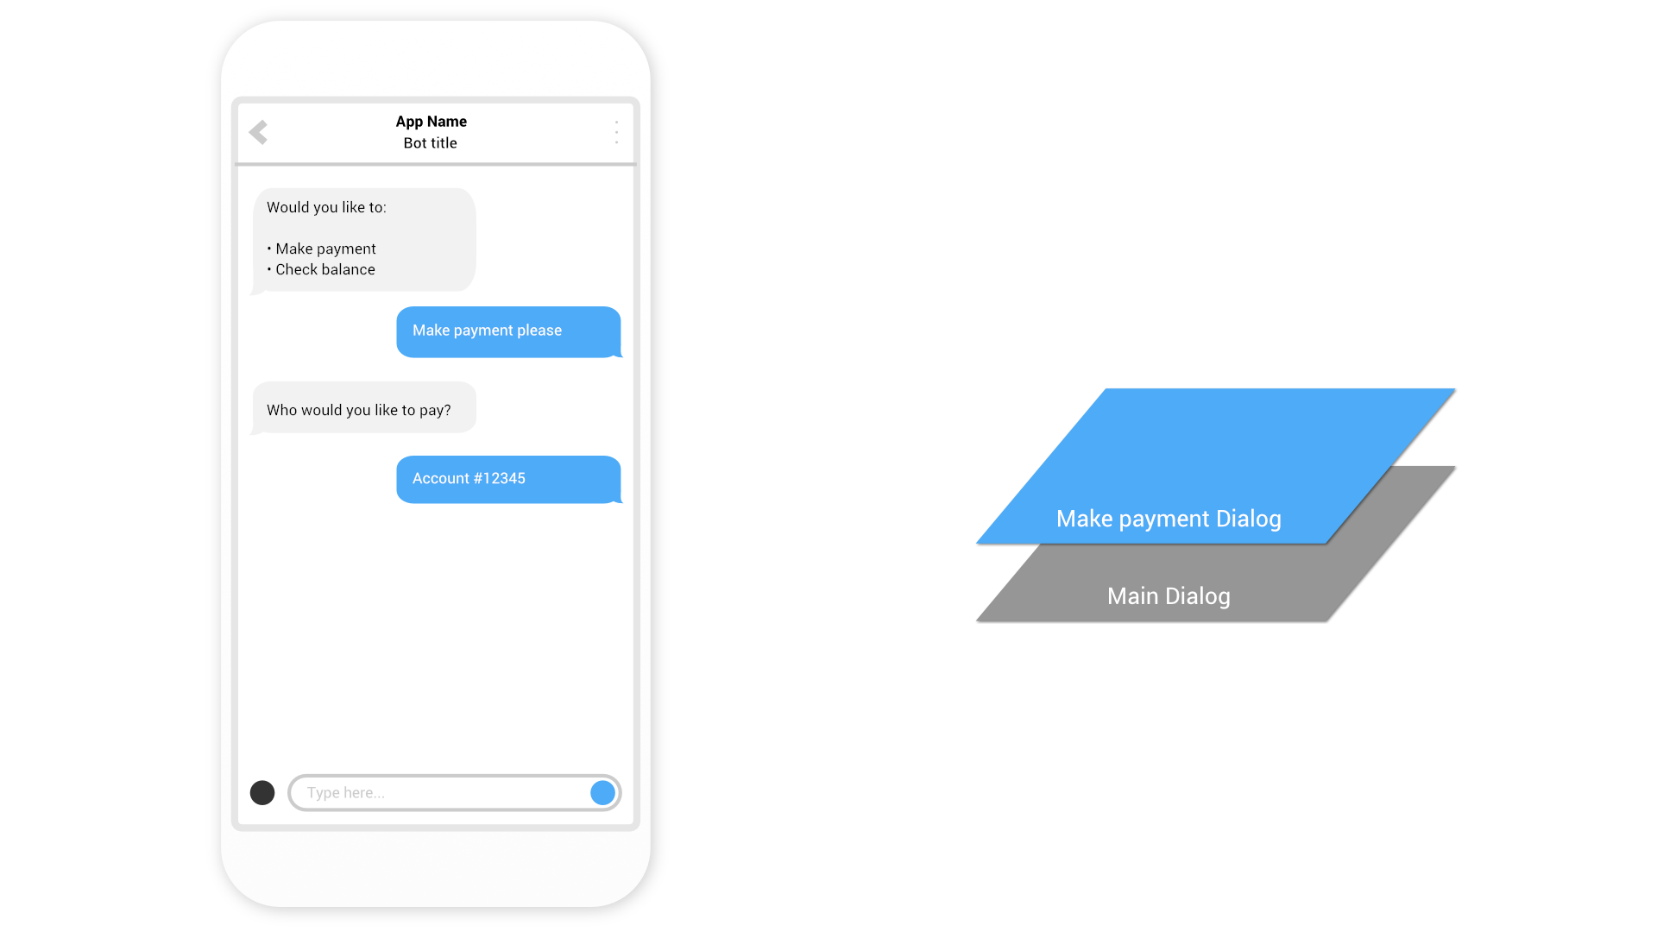

Slide 42


Slide 43
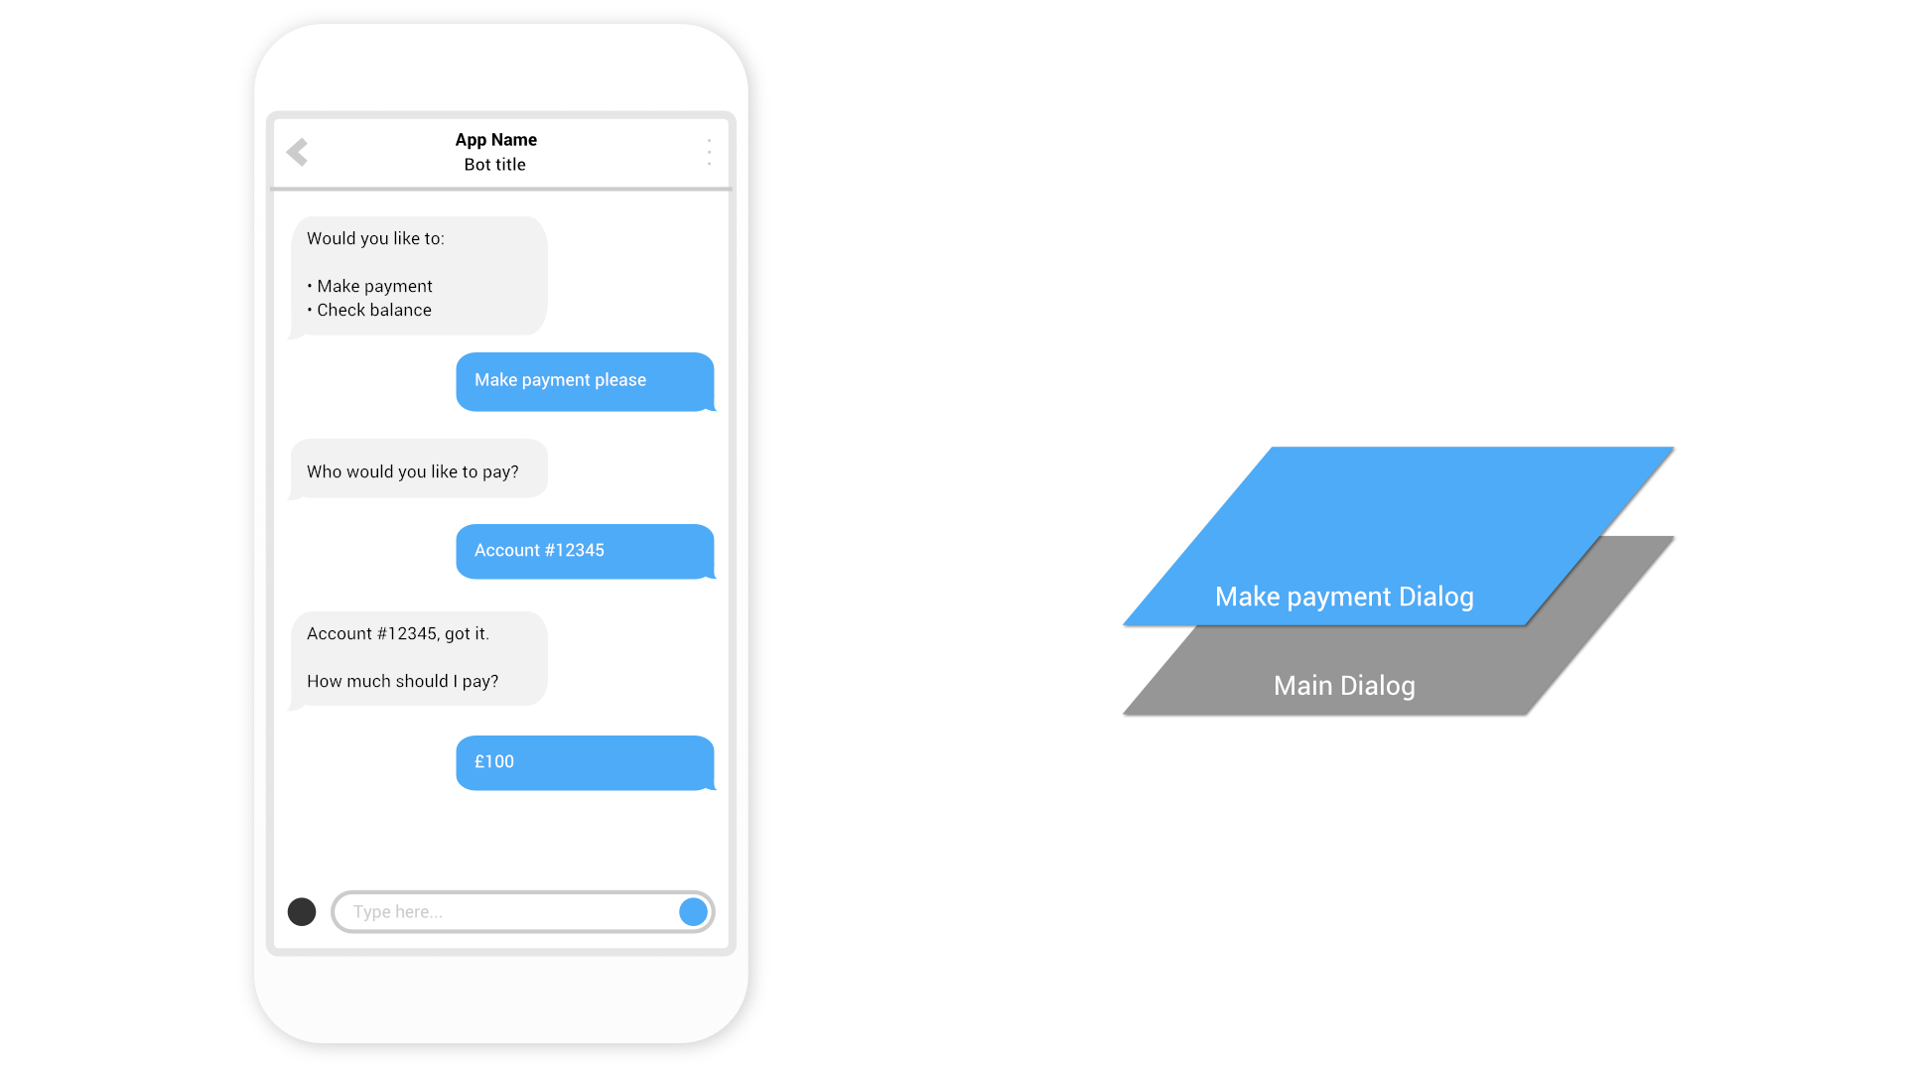

Slide 44
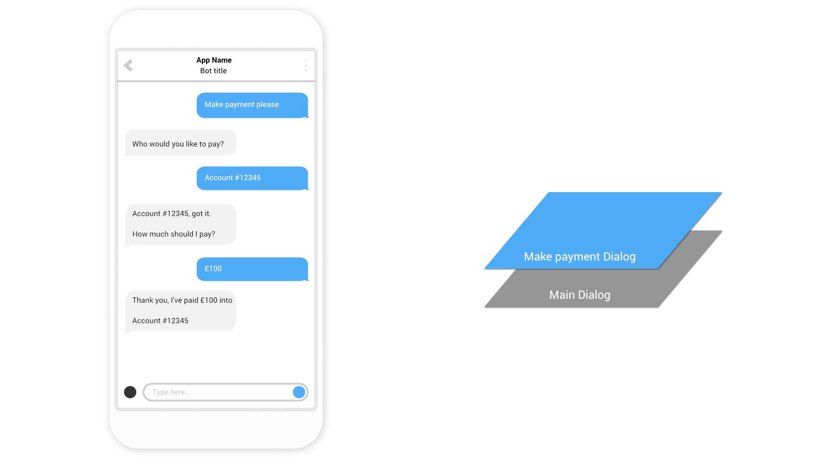

Slide 45
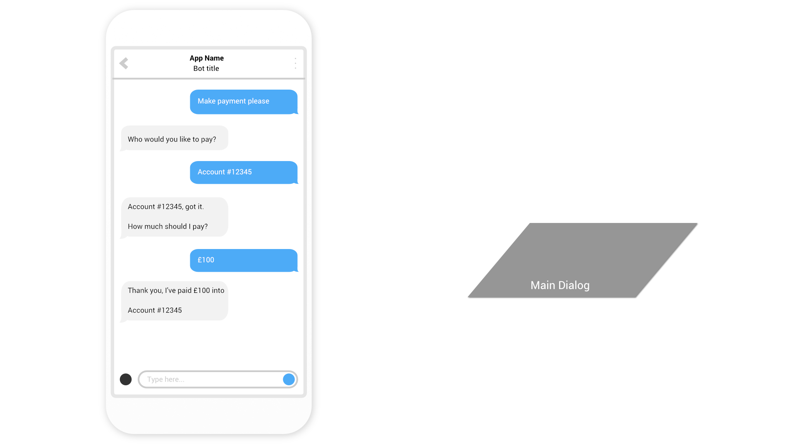

Slide 46
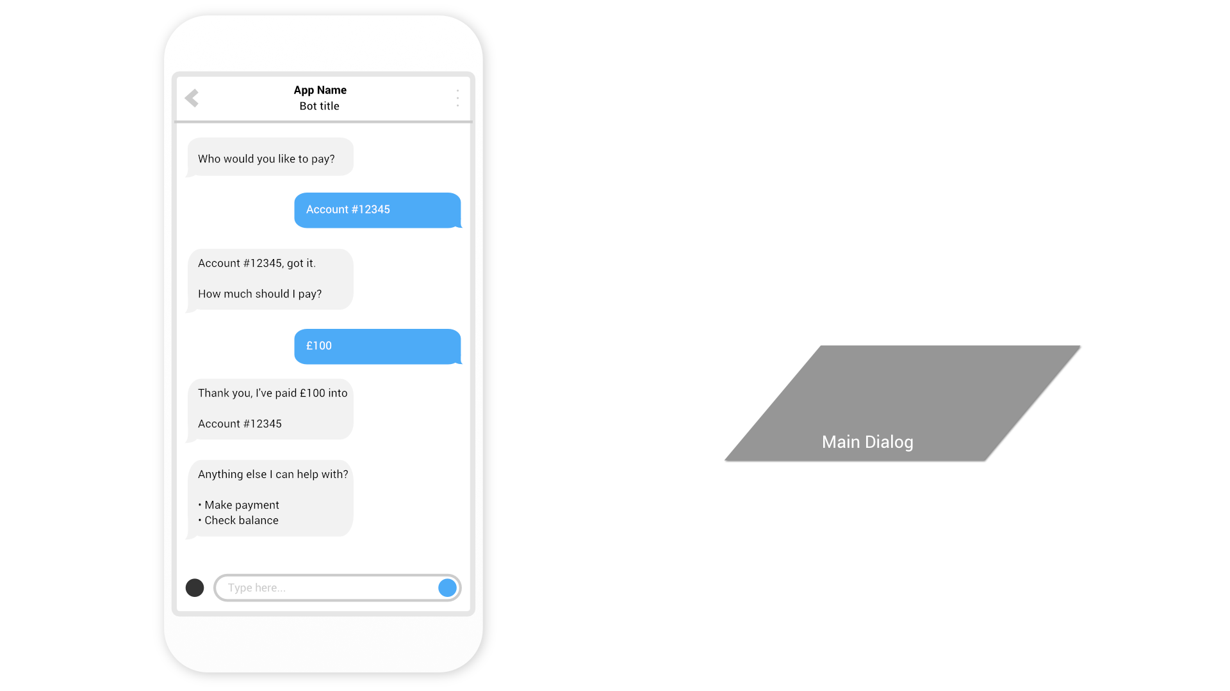

Slide 47
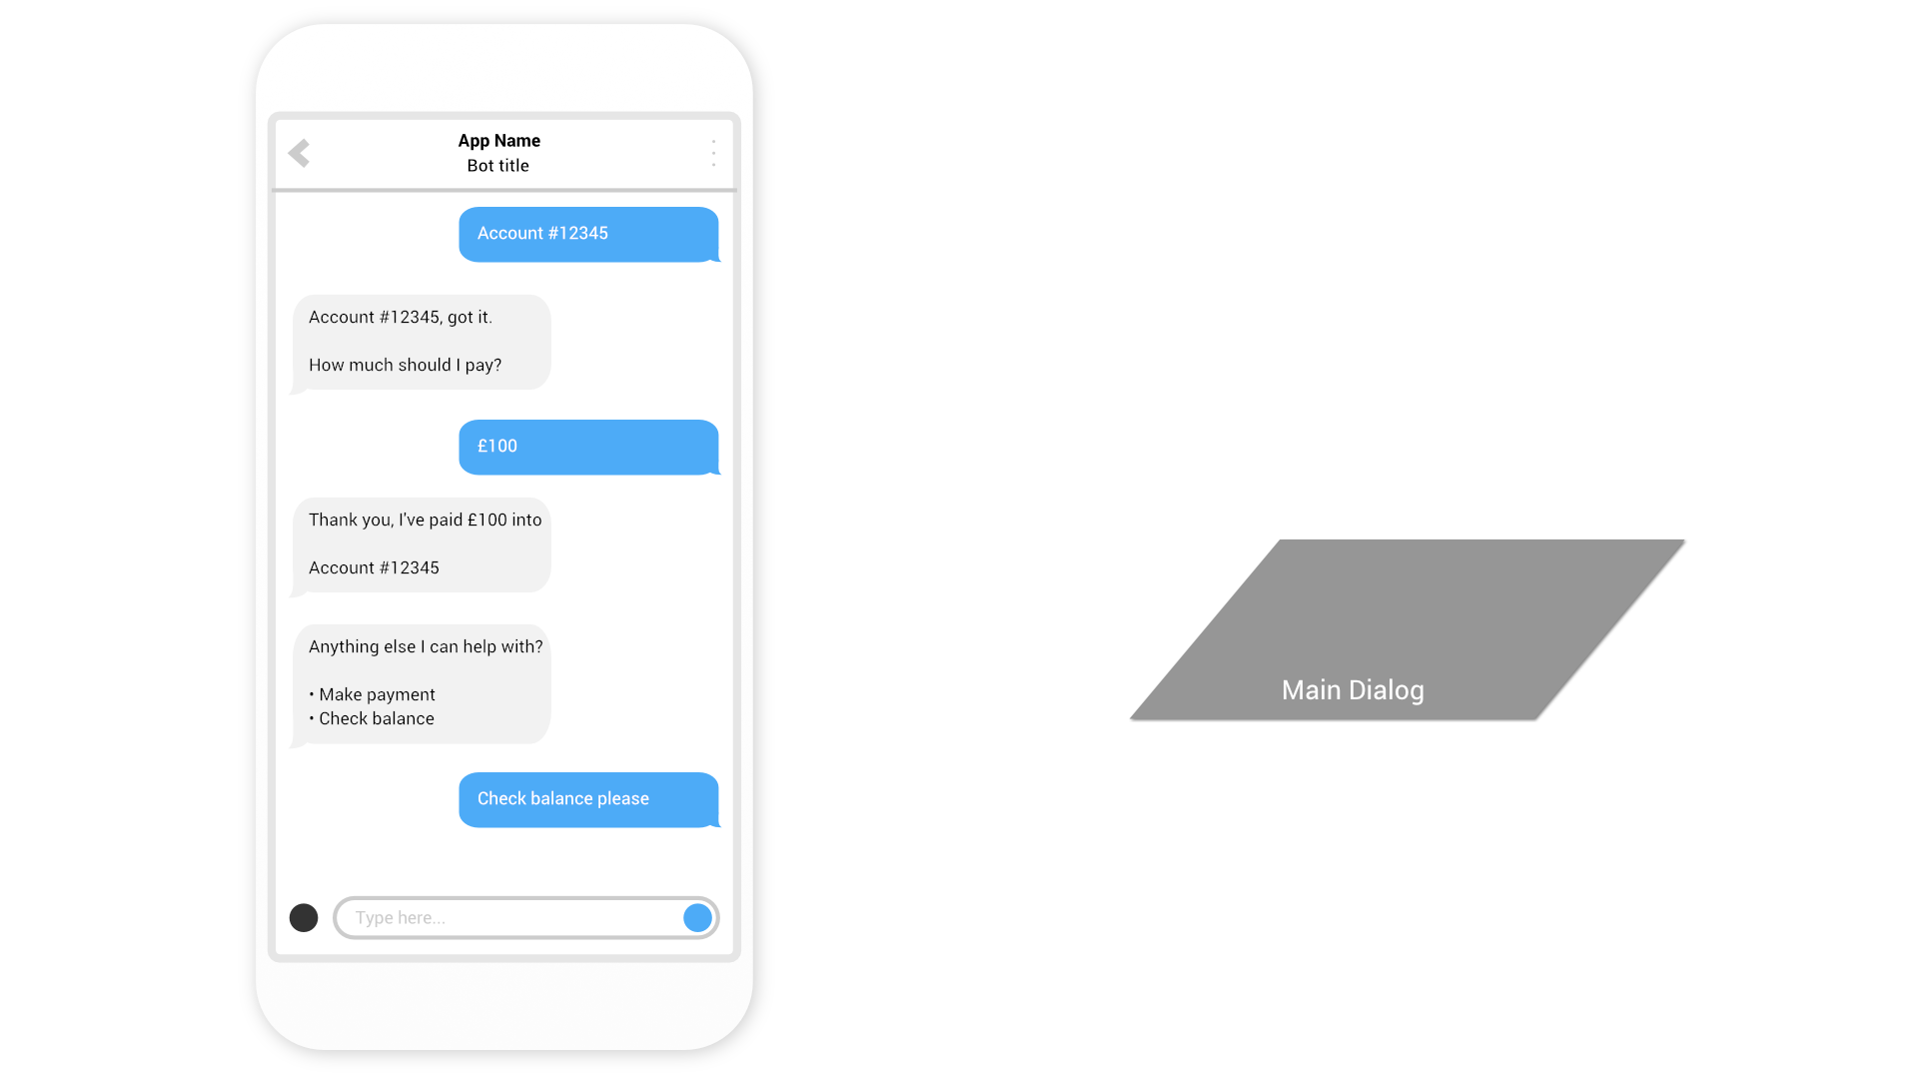

Slide 48
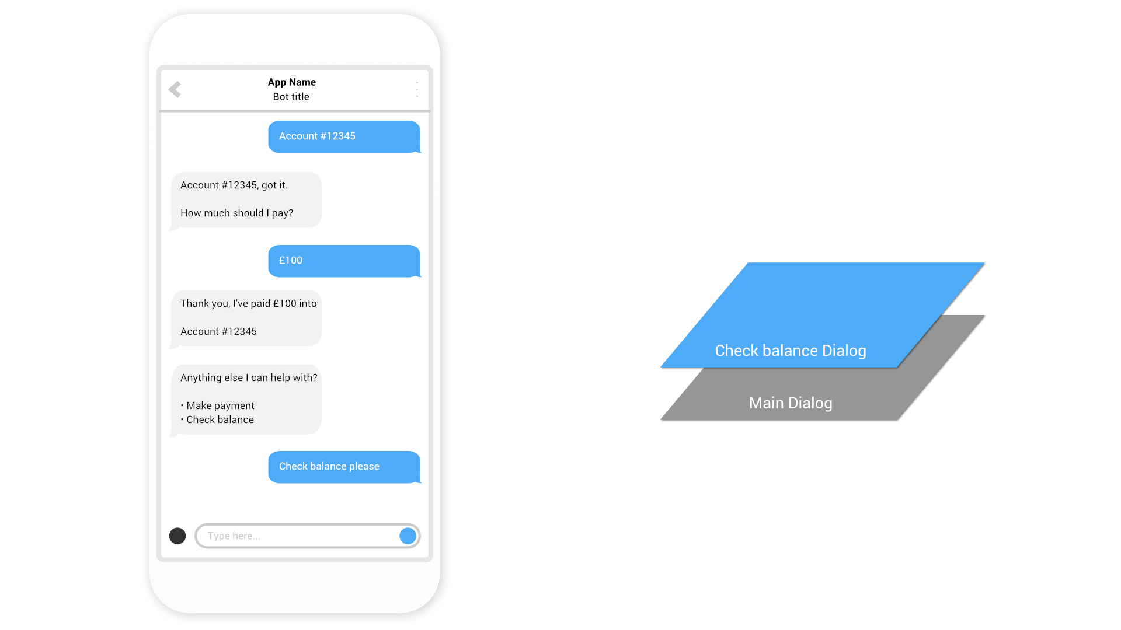

Slide 49
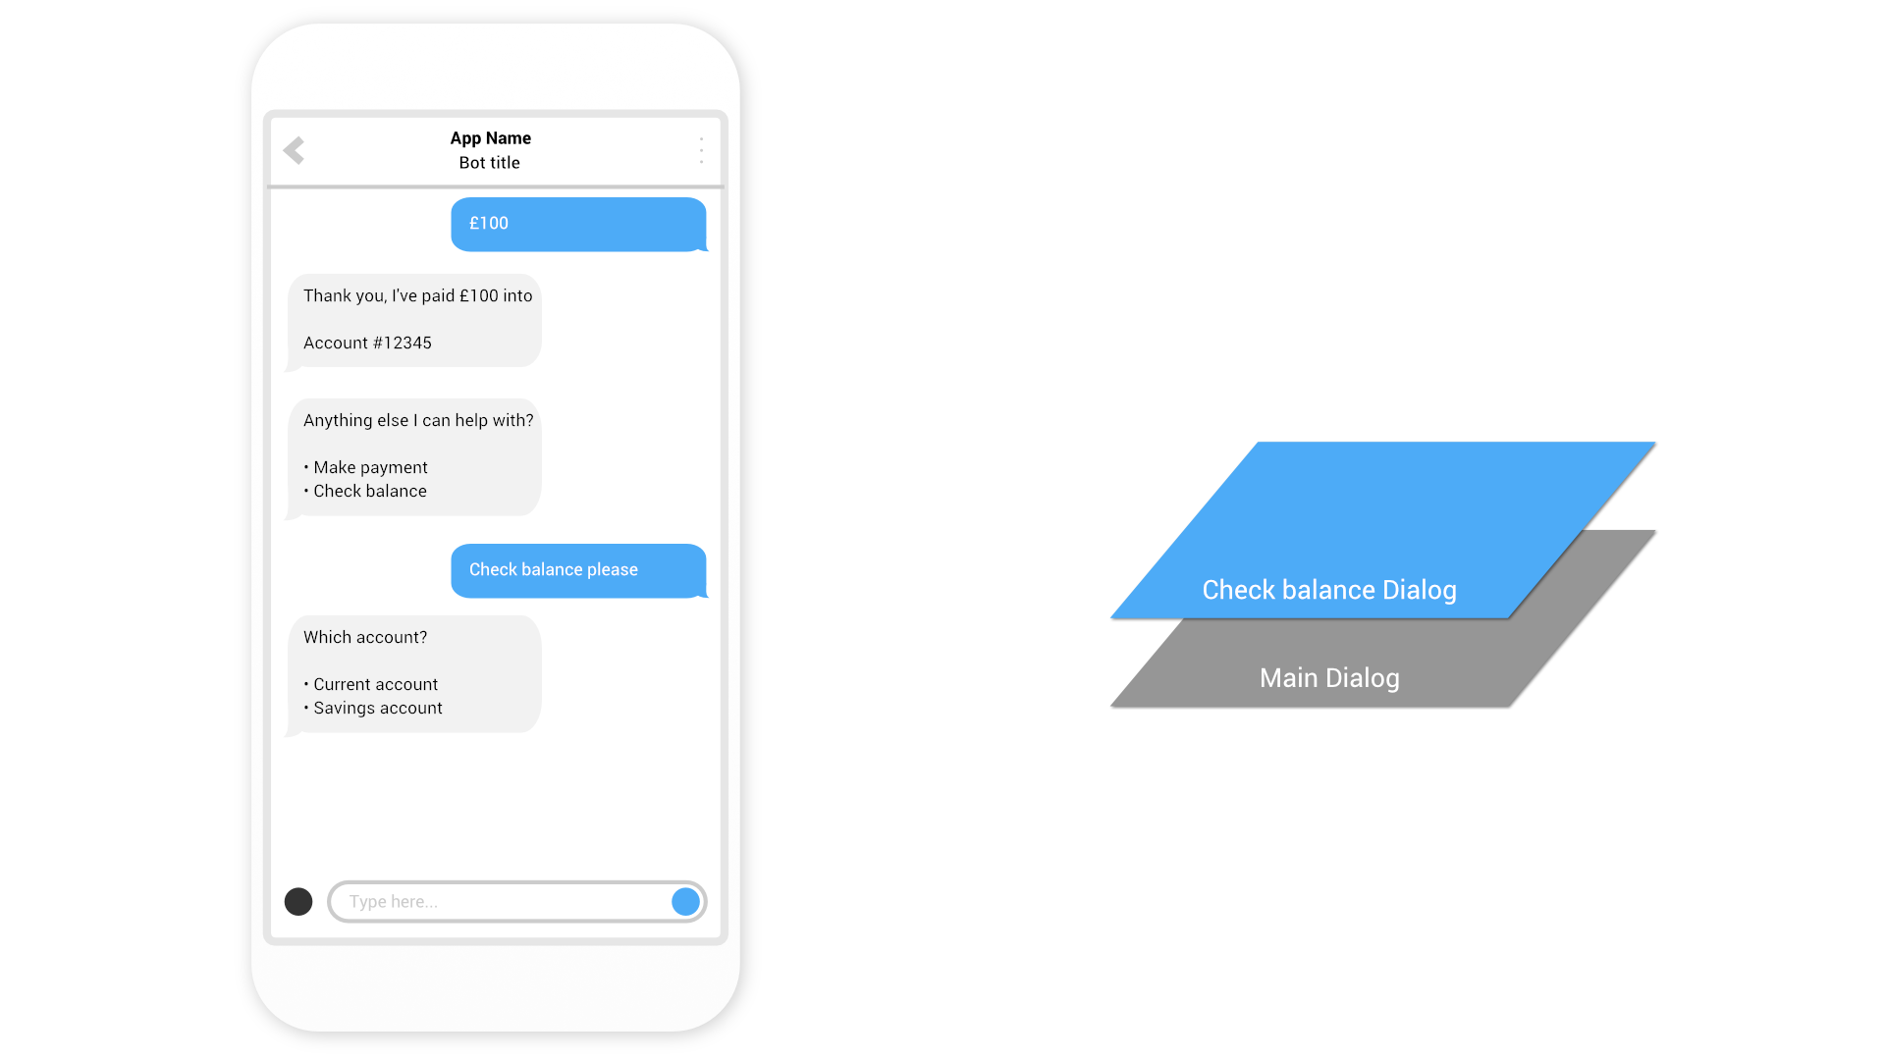

Slide 50
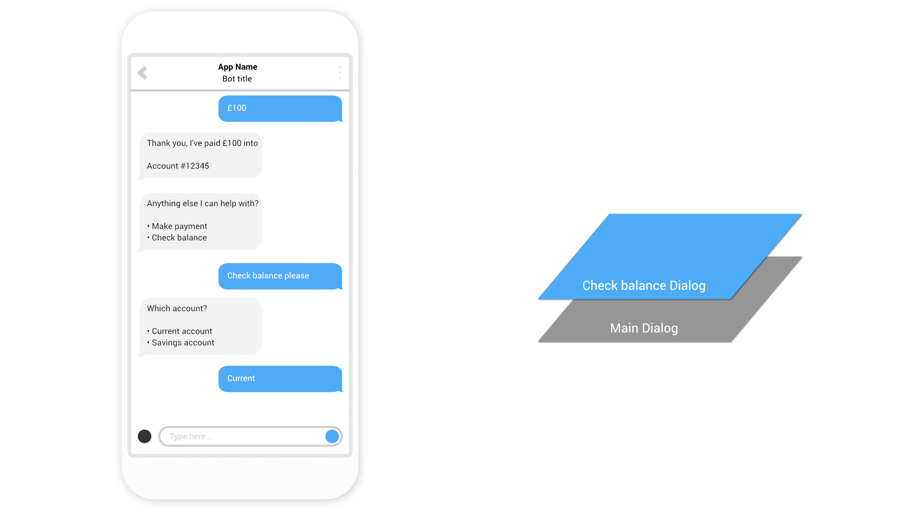

Slide 51
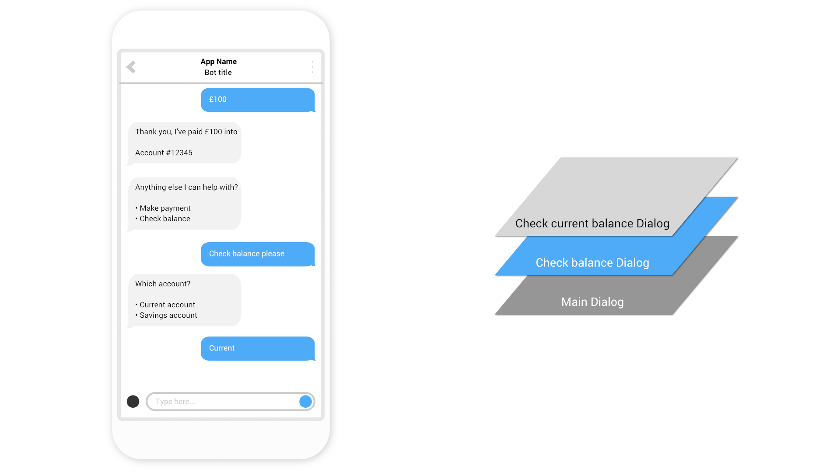

Slide 52
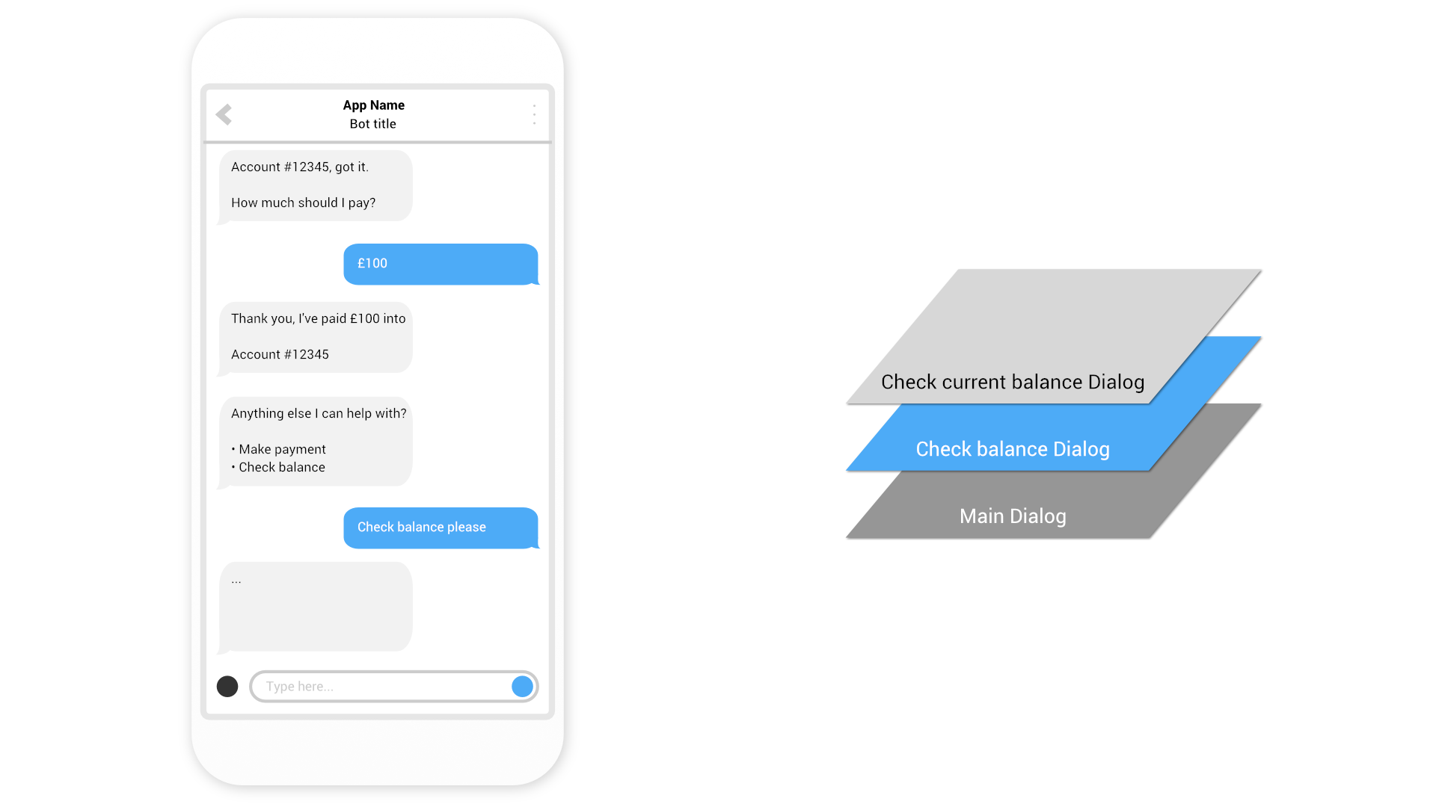

Slide 53
Defining Dialogs
Your bot needs to define top-level dialogs in a DialogSet using either:
Prompts Use DialogSet.Add(string dialogId, IDialog dialog) with *Prompt to add functions that prompt the user for input and process the response
Waterfall Steps Use DialogSet.Add(string dialogId, WaterfallStep[] steps) to add WaterfallSteps which allow the Dialog to flow from one interaction to the next
Composite Dialogs Use DialogSet.Add(string dialogId, IDialog dialog) with DialogContainer to add composite Dialogs that contain other Dialogs
To create an effective conversation it is typical to use a mix of Prompts, DialogContainers and WaterfallSteps
Notes:
So how do we deliver this ‘layering’?
We use dialog transitions
There’s more , but these are the important ones

Slide 54
Demo
Banking bot using dialogs
@jamesemann
Notes:
Introductions and Agenda (2 Mins)
Introduce Simon, Gary, James
Set expectations: intro to bot framework.
Very quick demo of JUST EAT to show what a bot is
What we are going to cover

Slide 55
QnA Maker
@jamesemann
Notes:
Introductions and Agenda (2 Mins)
Introduce Simon, Gary, James
Set expectations: intro to bot framework.
Very quick demo of JUST EAT to show what a bot is
What we are going to cover

Slide 56
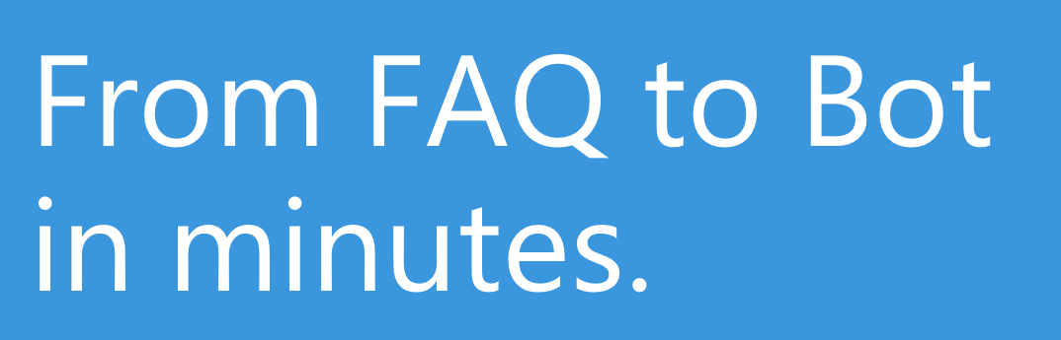

QnA Maker
Build, train and publish
Q&A bots based on existing FAQs
https://www.qnamaker.ai
Notes:
Common requirement for chat bots to surface answers to common questions
QnA Maker Service trains AI to respond to questions in a natural conversational way
Integrates easily with bots built using the Bot Framework – it is just a REST based API
Really easy way to get a bot up and running and start seeing the benefits!
http://qnamaker.ai
------------------------------------------------------
Brief overview of the QnA maker
Sign into qnamaker.ai
Create a new service using https://azure.microsoft.com/en-gb/support/faq/
Try "What does it mean if a service is in preview" -> show that we receive the right answer
Talk about training
Try "How do I raise a support request?" -> We get an answer but not the right one. Let's type "How do I submit a support request?" -> Get the right answer and add "How do I raise a support ticket?" as alternative phrase and re-train
Now try "How do I create a ticket with support?" -> get the right answer
Publish the service
Switch to bot demo in VS and show how we are calling our QnA Maker service and demo the bot
Maybe show my QnAMakerDialog available on NuGet??? YES

Slide 57
Demo
qnamaker.ai
@jamesemann
Notes:
Introductions and Agenda (2 Mins)
Introduce Simon, Gary, James
Set expectations: intro to bot framework.
Very quick demo of JUST EAT to show what a bot is
What we are going to cover

Slide 58
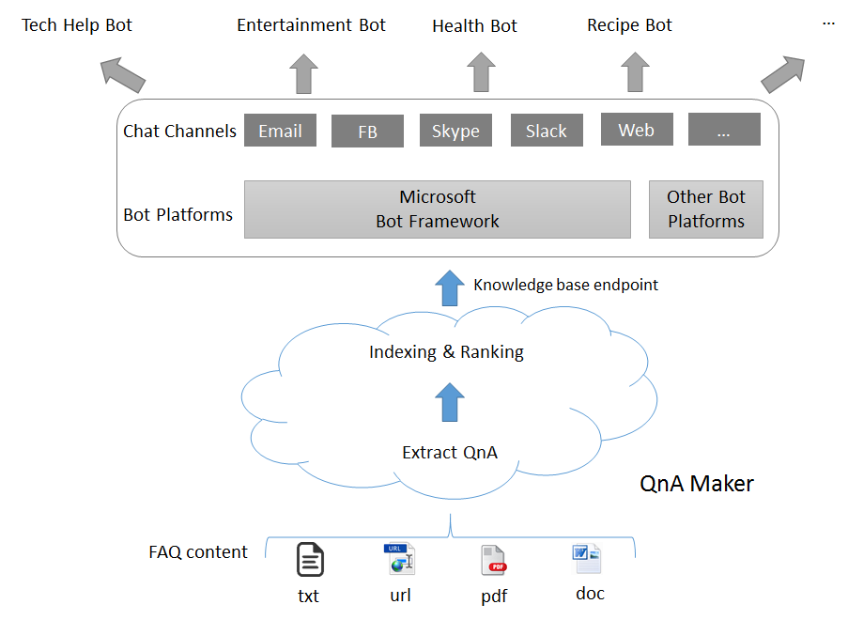
Demo
Banking bot using Dialogs
@jamesemann
Notes:
Introductions and Agenda (2 Mins)
Introduce Simon, Gary, James
Set expectations: intro to bot framework.
Very quick demo of JUST EAT to show what a bot is
What we are going to cover

Slide 59
Demo
Customer support bot
@jamesemann
Notes:
Introductions and Agenda (2 Mins)
Introduce Simon, Gary, James
Set expectations: intro to bot framework.
Very quick demo of JUST EAT to show what a bot is
What we are going to cover

Slide 60
luis.ai
@jamesemann
Notes:
Introductions and Agenda (2 Mins)
Introduce Simon, Gary, James
Set expectations: intro to bot framework.
Very quick demo of JUST EAT to show what a bot is
What we are going to cover

Slide 61
luis.ai terminology
Utterance (input)
A spoken or written message
Intent (output)
What is the user intending to do?
Entity (output)
What objects are being referred to?
“Set the temperature in the kitchen to 21 degrees”
“Set the temperature in the kitchen to 21 degrees”
“Set the temperature in the kitchen to 21 degrees”
Notes:
There’s more , but these are the important ones

Slide 62
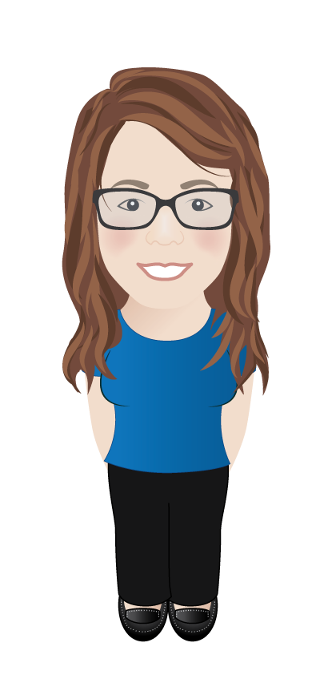
luis.ai intent recognition & entity extraction
“Set the temperature in the kitchen to 21 degrees”
“Set the temperature in the kitchen to 21 degrees”
“Set the temperature in the kitchen to 21 degrees”
Intent
Set temperature
Model
(luis.ai API)
Entities
Room = Kitchen
Temperature = 21 degrees
Notes:
There’s more , but these are the important ones

Slide 63
luis.ai components
Portal
Api
Define
Train
Publish
Consume
Notes:
Portal
Used to define intents and entities, and to train the model
Api
Used to consume the model, i.e. understand the intent of sentences

Slide 64
Demo
Home automation model in luis.ai portal
@jamesemann
Notes:
Introductions and Agenda (2 Mins)
Introduce Simon, Gary, James
Set expectations: intro to bot framework.
Very quick demo of JUST EAT to show what a bot is
What we are going to cover

Slide 65
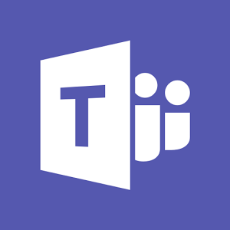
A more intelligent bot
Channels
Bot Application
luis.ai
Your bot
Luis Middleware
Model
API Controller
Notes:
There’s more , but these are the important ones

Slide 66
Demo
Luis middleware bot
@jamesemann
Notes:
Introductions and Agenda (2 Mins)
Introduce Simon, Gary, James
Set expectations: intro to bot framework.
Very quick demo of JUST EAT to show what a bot is
What we are going to cover

Slide 67
Cards
@jamesemann
Notes:
Introductions and Agenda (2 Mins)
Introduce Simon, Gary, James
Set expectations: intro to bot framework.
Very quick demo of JUST EAT to show what a bot is
What we are going to cover

Slide 68
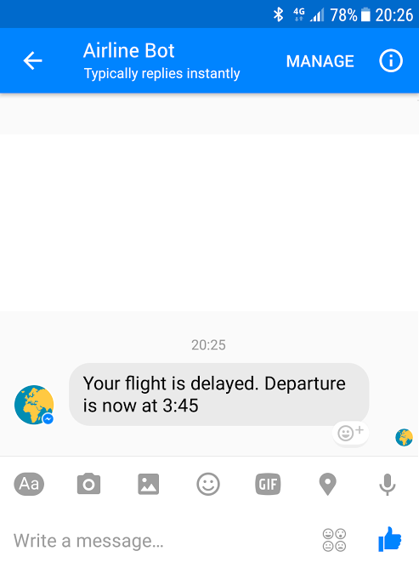
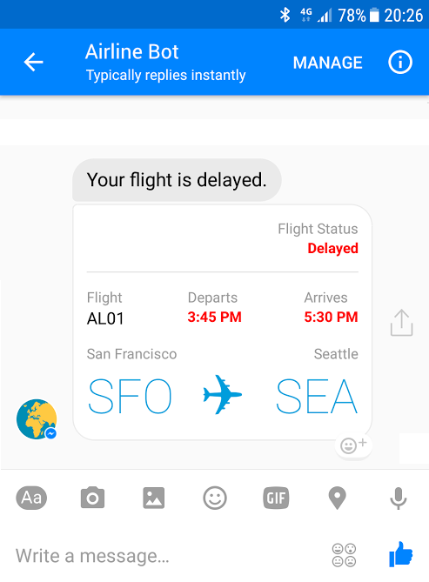
Bots can be more engaging using cards
Notes:
There’s more , but these are the important ones

Slide 69
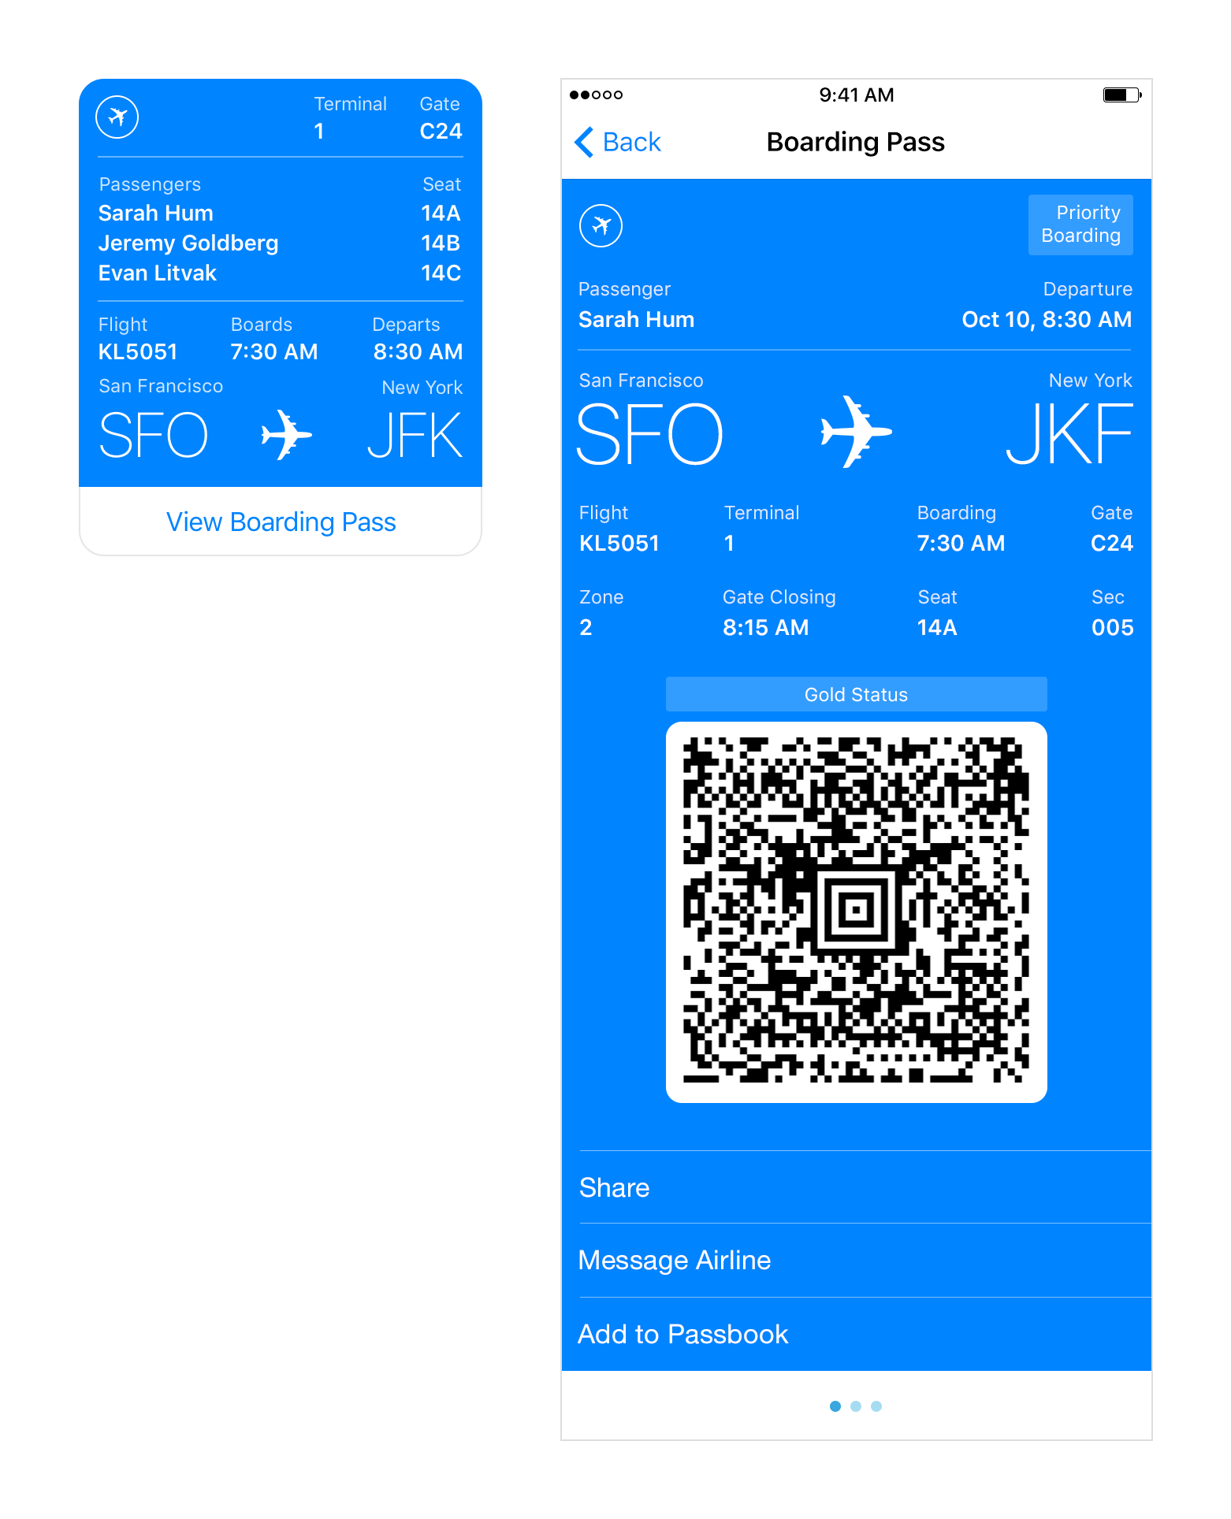
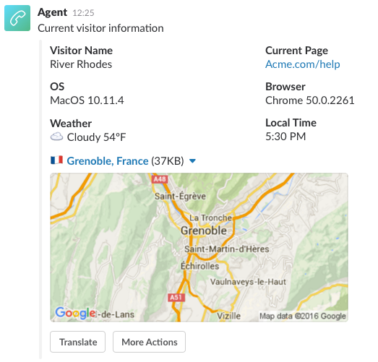
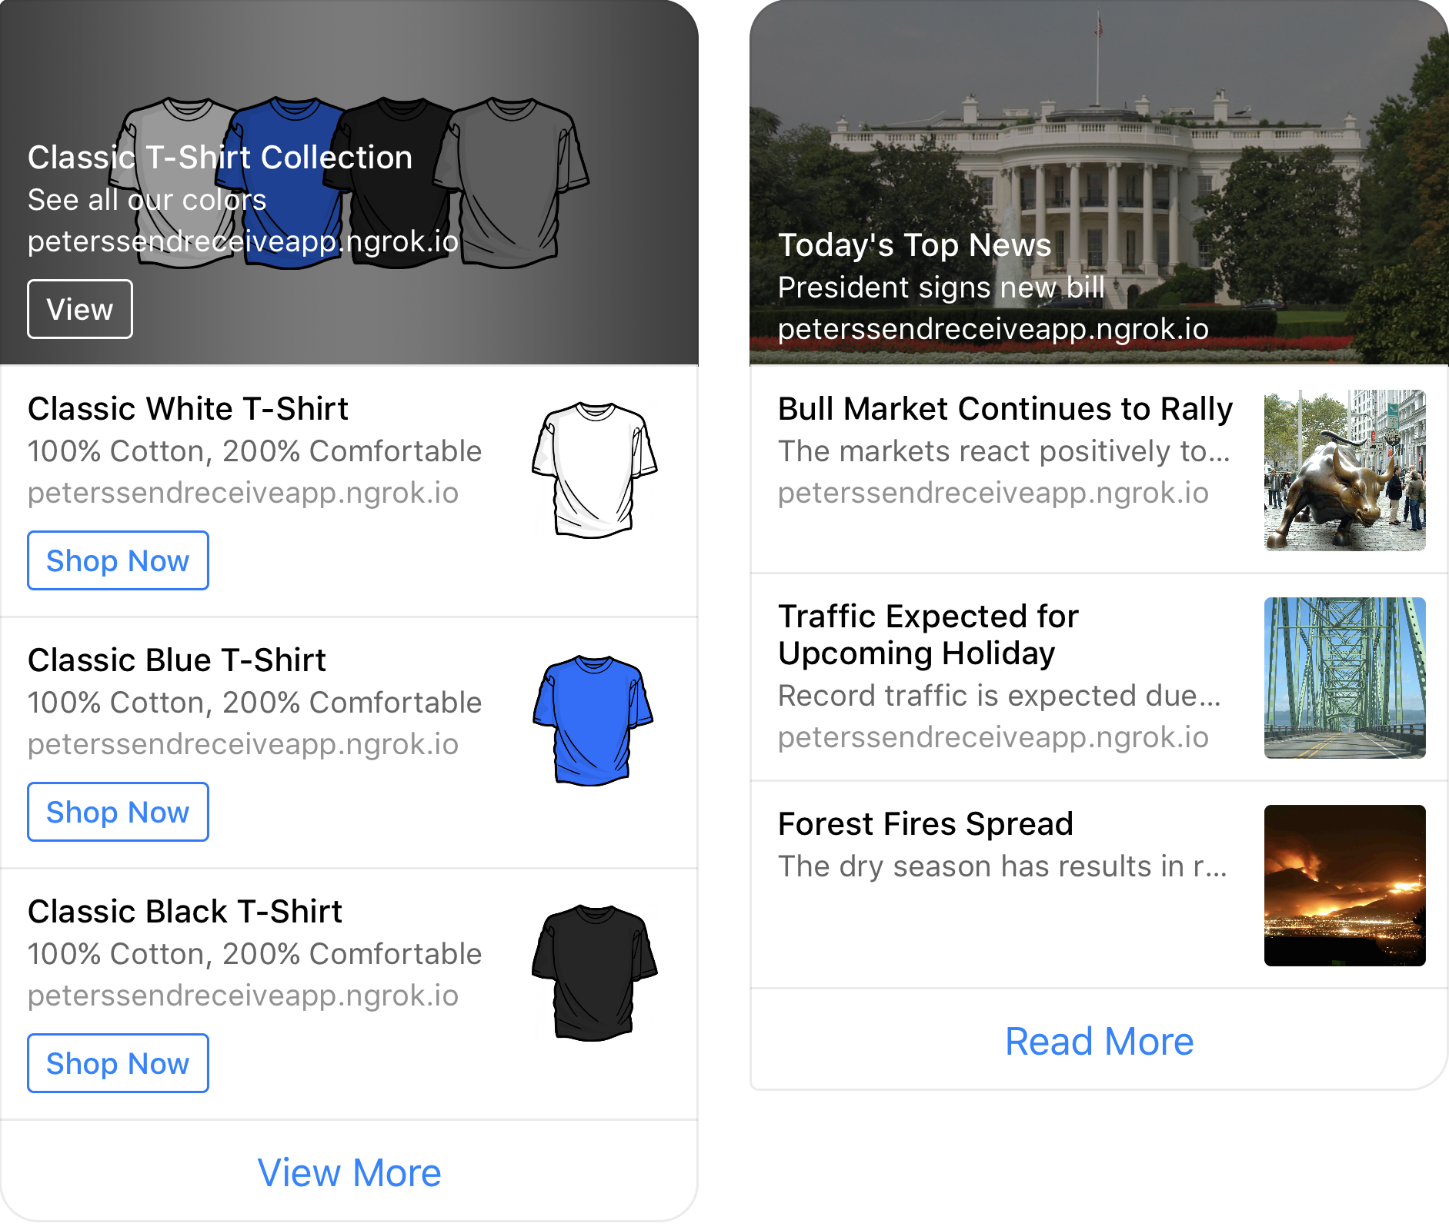
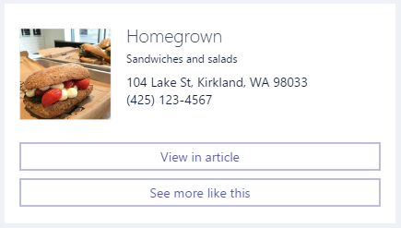
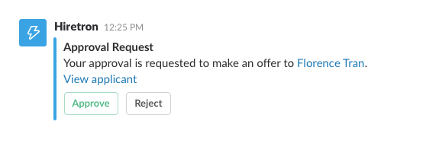
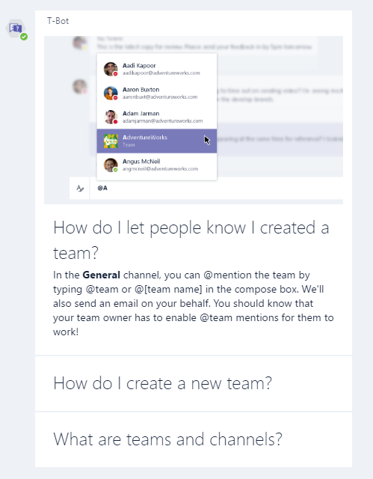
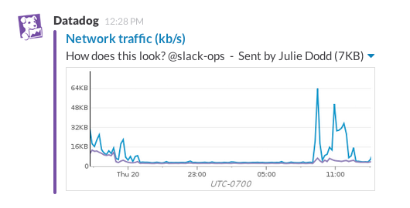
Notes:
There’s more , but these are the important ones

Slide 70
Creating cards using BotBuilder
1. Create activity
2. Create card
3. Add the card to the activities
list of attachments.
IMessageActivity message = context.Activity.CreateReply();
HeroCard card = new HeroCard()
{
Title = $"Appointment with doctor"
});
IMessageActivity message = context.MakeMessage();
message.Attachments.Add(new Attachment()
{
ContentType = HeroCard.ContentType,
Content = card
});
Notes:
There’s more , but these are the important ones

Slide 71
Adaptivecards.io

Slide 72
Demo
Cards
@jamesemann
Notes:
Introductions and Agenda (2 Mins)
Introduce Simon, Gary, James
Set expectations: intro to bot framework.
Very quick demo of JUST EAT to show what a bot is
What we are going to cover

Slide 73
Proactive bots
@jamesemann
Notes:
Introductions and Agenda (2 Mins)
Introduce Simon, Gary, James
Set expectations: intro to bot framework.
Very quick demo of JUST EAT to show what a bot is
What we are going to cover

Slide 74
Bot communication isn’t always synchronous
Reminders and alerts
“Your flight is delayed”
Long running tasks
“Started the build… I’ll let you know when it’s done”
“The build is complete”
Human in the loop (human handoff)
Notes:
There’s more , but these are the important ones

Slide 75
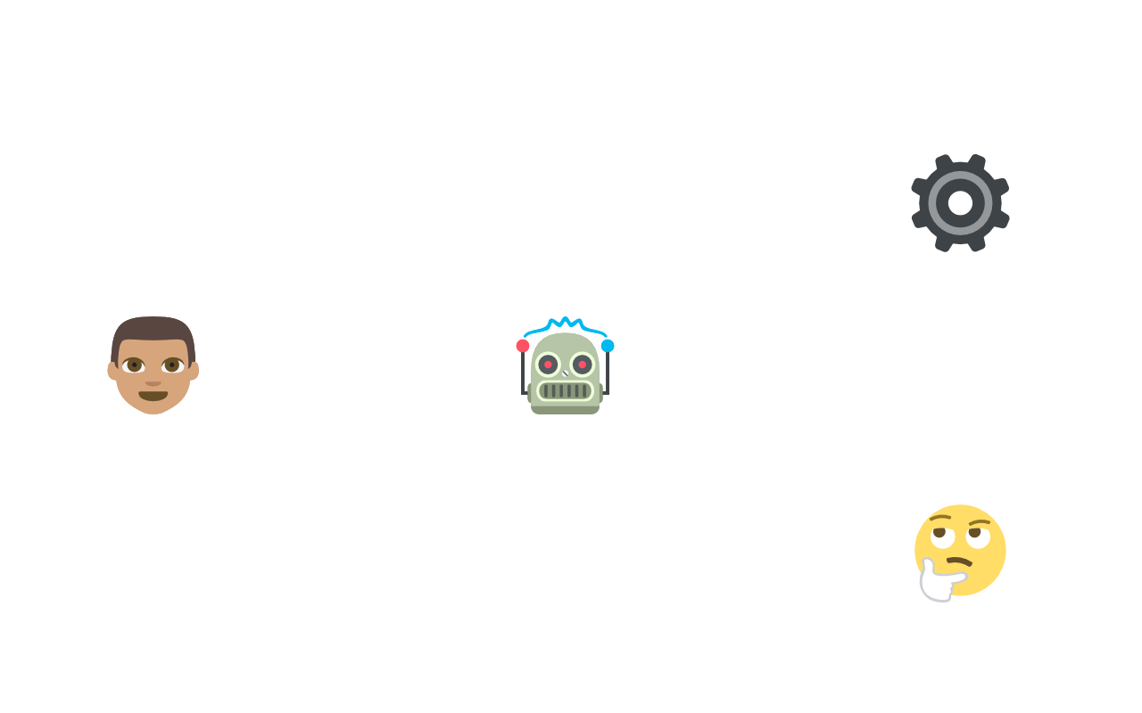


Resuming a conversation
“Business as usual”
“Human handoff”
Bot Application
User
Bot
Customer support

Slide 76
Demo
Customer support proactive Bot
@jamesemann
Notes:
Introductions and Agenda (2 Mins)
Introduce Simon, Gary, James
Set expectations: intro to bot framework.
Very quick demo of JUST EAT to show what a bot is
What we are going to cover

Slide 77
Pricing – as of 21/07/18
Bot Framework
QnaMaker.ai
LUIS.ai
 | Premium Channels (direct line/webchat) | Standard Channels
FREE TIER | £0.373 per 1,000 messages | Unlimited Messages free
S1 TIER | 10,000 messages free per month | Unlimited Messages free
 | Managed documents | Resource costs
FREE TIER | 3 free managed documents; up to 1 MB each | App Service + Azure Search
STANDARD TIER | £7.454/month unlimited managed documents | App Service + Azure Search
 | Text Requests
FREE TIER | 10,000 free transactions per month
LUIS API—Text Requests | £1.118 per 1,000 transactions
Notes:
There’s more , but these are the important ones

Slide 78
Thank you!
Create an account @ dev.botframework.com
Download the emulator + Node/C# SDK
Start providing a conversational interface to your existing apps!
<GITHUB URL>
Notes:
There’s more , but these are the important ones

Slide 79
Resources
Blogs:
James Mann:
blogs.blackmarble.co.uk/blogs/jmann/
Twitter:
@jamesemann
Useful links:
Bot samples, tutorials, case studies:
aka.ms/botresources
Bot framework:
dev.botframework.com
github.com/microsoft/BotBuilder
github.com/microsoft/BotBuilder-samples
Cognitive Services:
aka.ms/cognitive
Notes:
Introductions and Agenda (2 Mins)
Introduce Simon, Gary, James
Set expectations: intro to bot framework.
Very quick demo of JUST EAT to show what a bot is
What we are going to cover

